Slide 1
Unit 4
“The focus of this unit is local, regional and global challenges to health. Despite incredible improvements to health over many years, life expectancy rates within and across populations vary considerably. Students learn about the impact of social determinants on global inequities and other challenges to health, and approaches to address barriers which prevent groups from experiencing better health outcomes. Students examine international health agencies and global and local initiatives designed to improve health. Students further refine and apply investigative skills to analyse health issues, develop well-constructed arguments, and draw evidence-based conclusions.”
-SCSA Syllabus

Slide 2
Health promotion: advocacy
Term 2
Week 9

Slide 3
Syllabus content
Definition of health promotion advocacy and when it is best used
Strategies for health promotion advocacy
Lobbying
Raising awareness
Creating debate
Developing partnerships
Building capacity
Mobilising groups
Framing issues
Using champions
Influencing policy

Slide 4
Health promotion Advocacy: what is it?
Definition: Active support and campaigning for health issues, in particular the act of pleading or arguing for health programs or health goals.
What is an ADVOCATE? A person who pleads for a cause or pushes an agenda.
What is it used for?
Raising public awareness on the issue
Increasing public acceptance of the issue
Influencing public policy
Influencing resource allocation decisions

Slide 5
Advocacy: when is it best used?
When a population group, cause or health issue is disadvantaged, suppressed or forgotten.
It works well in a democratic environment (where citizens have a voice)
It works when a community is not yet receptive to change (as per the PABCAR model)

Slide 6
Strategies for advocacy:
Let’s begin with an example of effective advocacy:
Black Lives Matter explained: The history of a movement (15 mins)
https://www.youtube.com/watch?v=YG8GjlLbbvs
Lobbying
Raising awareness
Creating debate
Developing partnerships
Building capacity
Mobilising groups
Framing issues
Using champions
Influencing policy

Slide 7
Strategies for advocacy: lobbying
IT’S ALL ABOUT INFLUENCING PUBLIC POLICY.
Lobbying is the act of attempting to influence decisions made by government officials, legislators, business or regulatory agencies to create or change legislation.
It aims to change policy at the local, national and global level.
Lobbying requires the persuasion of government representatives to support your position.
Lobbying also requires you to identify other stakeholders whose cooperation and/or influence may assist you.
Lobbying involves skills that include contacting officials, effective communication and challenging opposing views/opinions.

Slide 8

Strategies for advocacy: raising awareness
“Raising awareness” involves increasing people’s knowledge or perception of a situation.
Usually this is done by:
Education programs to increase health literacy or modify A,B,Vs.
Disseminating information to the public so they can increase discussions on the topic.
Use of contemporary technology (social media, advertising, use of the internet-think: #hashtagging and retweeting

Slide 9
Raising awareness example: Ice bucket challenge
https://www.youtube.com/watch?v=P-RHswHbnow
In 2014, the #icebucketchallenge was set up to raise awareness of Motor Neuron Disease which causes ALS (amytrophic lateral sclerosis)
Through the use of hashtags and other social media sharing strategies, it raised awareness of this disease.
Can you think of any other similar campaigns?

Slide 10
Strategies for advocacy: creating debate
Creating debate involves opening a forum for formal discussion on a particular issue.
Opposing arguments are presented on the issue and a resolution is usually made in the form of an audience vote.
Recently, more debates take place over a longer period of time-allowing opposing sides to gather resources and develop points to be shared when they desire.
Debates are best used on controversial or ethical issues so that all viewpoints and opinions can be heard and discussed.
Social media has created a floor for debates with people all over the world having the opportunity to express their opinion-in comments sections usually.

Slide 11
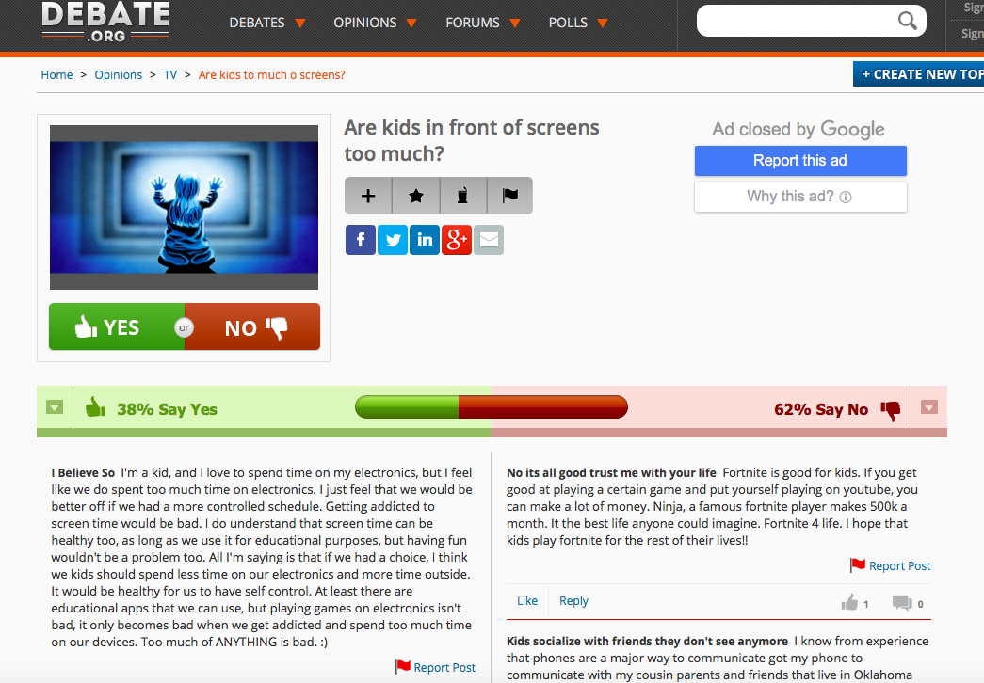
Creating debate example: debate.org
http://www.debate.org/opinions/are-kids-in-front-of-screens-too-much

Slide 12
Strategies for advocacy: developing partnerships
When organising an advocacy initiative, an important step is to target any organisations, agencies and companies that already support the issue.
This will strengthen the action!
Two key partnerships:
1. other advocacy groups that are also advocating your issue
2. other groups that share your target audience.

Slide 13
Developing partnerships example:
The issue: School canteens providing unhealthy foods for school children to purchase.
Two groups to partner with:
1. other advocacy groups that are also advocating your issue…groups like the heart foundation, live lighter campaign.
2. other groups that share your target audience…parents, teachers, sports coaches and local community groups like church groups
WHY would this be more effective?

Slide 14
Strategies for advocacy: building capacity
Capacity building is the development and strengthening of human and institutional resources.
What might this look like as an advocacy strategy?
Increasing people power (volunteers, staff)
Increasing the effectiveness of the workers
Increasing funding and time allocation on the issue.
Improving facilities and infrastructure
This can help organisations to build their capacity to meet health goals.

Slide 15

Building capacity example: healthway
Healthway is a government agency that gives financial grants to community groups so that they can implement health promoting programs
These grants allow these organisations to:
Improve their resources
Build better infrastructure
Upskill teaching and support staff through training programs
This, in turn, will build the capacity of the organization to promote healthy outcomes.

Slide 16
Strategies for advocacy: mobilising groups
Mobilising groups involves uniting groups of people to act in a certain way to make a difference. (Get them to ACT by organising and encouraging them)
When is this required?
Usually when numbers are required to support an issue, for example in LOBBYING efforts.
Large groups of people are harder to look over or ignore when they are advocating for something to change.

Slide 17
Strategies for advocacy: framing issues
Framing refers to the way an idea is presented in a particular way to elicit the desired response.
People will often react differently to an issue if it is presented in a negative light versus a positive light.
Health promotion advocacy attempts should try to frame the issue positively to attract followers.
When raising awareness on a health issue the issue is often framed in a way that makes the situation more appealing for funding/assistance.
It is IMPORTANT that the target audience is identified first. THEN, we can identify how the issue will be perceived by the audience and we can then frame the issue in the most appropriate way.

Slide 18
Framing issues example:
Evidence suggests that health promotion campaigns that are “GAINED-FRAMED” are more likely to result in participation in preventive strategies than campaigns that are “LOSS-FRAMED”.
“Slow down and enjoy the ride” vs “speeding kills”
Another example?
“Do you think that Indigenous Australians should experience the same life expectancy as majority of Australians?”
vs
“Do you think that the Australian government should spend billions of taxpayers dollars on Indigenous Health programs to help bring their life expectancy in line with the majority of Australians life expectancy?

Slide 19
Strategies for advocacy: using champions
After the issue has been clearly defined and support has been mobilised, many advocacy campaigns will use a “CHAMPION” to help support their cause.
A champion is external to the advocacy group.
A champion is usually one of the following:
Celebrity (actors, athletes, tv personalities)-public ambassador
Politician-influence legislation
High profile business person -connection with resources

Slide 20
Strategies for advocacy: using champions
What do they do?
They should bring credibility to the issue
They should be passionate and knowledgeable on the issue
They should be enthusiastic about the purpose of the campaign
Note: the Champion does not have to be famous already, they can be created as a champion and then used to raise awareness. (think: Telethon child)

Slide 21
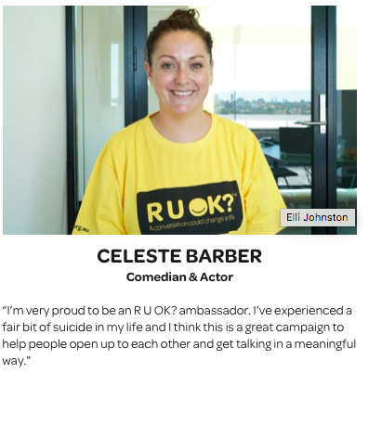

Using champions example: ruok? day
RU OK? Day uses a range of celebrities as champions to raise awareness of their campaign.

Slide 22
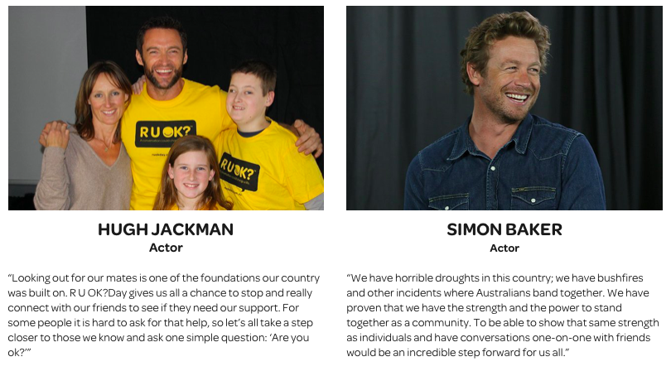
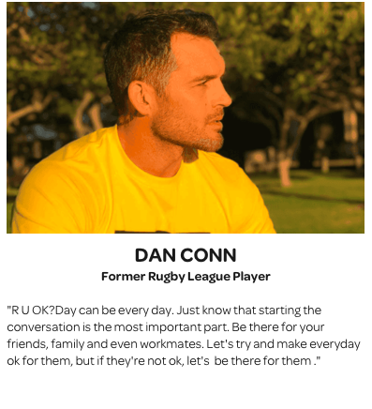
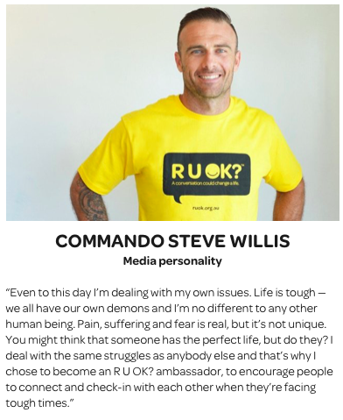
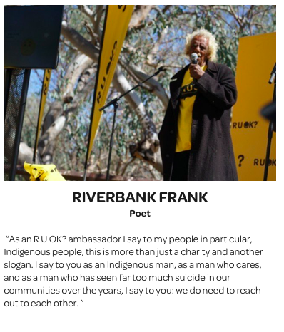

Slide 23
Strategies for advocacy: influencing policy
Very closely linked with LOBBYING.
We know that BUILDING HEALTHY PUBLIC POLICY is one of the Ottawa charter action areas.
Health promoters can influence policy makers to make policies that promote healthy behaviours and restrict unhealthy behaviours.
Influencing policy is usually accomplished through LOBBYING.

Slide 24
Sources:
Lockhart, E. (2015) Health Studies Year 12 ATAR.
Image retrieved from: http://jmedia.online/2016/11/23/pro-palestinian-funds-channelled-to-getup/
https://www.getup.org.au
http://www.who.int/tobacco/control/capacity_building/background/en/
Jeremy Porter Communications:
http://www.jrmyprtr.com/know-how-to-frame-your-issue/
https://www.ncbi.nlm.nih.gov/pubmed/21993844
https://www.ruok.org.au/people-behind-us

Slide 25
Impact of determinants on health inequities
Term 2
Week 9-10

Slide 26
Syllabus content
Impact of determinants on health inequities:
SOCIAL (11)
Social gradient
Social exclusion
Social support
Stress
Unemployment
Early life
Work
Food
Transport
Culture
addiction
SOCIOECONOMIC (8)
Education
Employment
Income
Family
Housing/Neighbourhood
Access to services
Migration/Refugee status
Food security
ENVIRONMENTAL (2)
Features of the natural and built environment
Geographical location
BIOMEDICAL (2)
Birthweight
Body weight

Slide 27
Reminder: health inequities definition
Health inequities: Avoidable inequalities in health between groups of people within countries and between countries. (Inequalities that are unfair or unjust.)

Slide 28
SOCIAL DETERMINANTS
What are the SOCIAL determinants?
Societal conditions in which people are born, live, grow, work and age.
These conditions are influenced by economics, politics and social policies
The social determinants are NOT EQUALLY DISTRIBUTED
Michael Marmot 4mins:
https://www.youtube.com/watch?v=BHYBHKma3x8&feature=youtu.be
**Remember from last year, “SUE WAS FORCED TO SING SONGS CONSTANTLY”
(11 social determinants)

Slide 29
Social determinants: Social Gradient
The poorest of the poor tend to have the worst health. As you move down the gradient, individuals tend to experience poorer health than those above them on the social gradient. (this gradient occurs on both a global scale, within countries and within communities)
Those lower on the social gradient often experience
“Poorer health” in the following areas:
Increased risk of serious illness and premature death (reduced
access to healthcare)
Fewer family assets
Having poorer education
Insecure employment
Living in poor housing or dangerous neighbourhoods
Living on inadequate retirement pension
Textbook Example:
In Scotland a baby born in the most disadvantaged neighbourhood in Glasgow can expect to live 10 years fewer than a baby living in the most affluent neighbourhood. Merely the fact a child is raised in a lower socioeconomic household should not be the reason they have a lower life expectancy.

Slide 30
Social gradient & health inequity
Individuals who are lower on the social gradient have fewer opportunities to improve their health and reduce health inequities.
All people have the RIGHT to the same opportunity to experience good health, but people lower on the social gradient often do not have access to this right (due to a range of environmental and social factors that are beyond their control)
Health inequities are exasperated when people higher on the social gradient have means/opportunities to prevent/remove the barriers to experiencing good health. People lower on the social gradient find it very difficult to overcome the barriers to good health.

Slide 31
Social determinants: unemployment
Individuals who are unemployed are often lower on the social gradient, and therefore experience poorer health (increased stress and social isolation)
Does ill health cause unemployment? Or does unemployment cause ill health???
Unemployment is often a contributing factor to homelessness (also linked with other health issues such as mental illness, drug use/addiction and domestic violence)
Unemployment over an extended period of time leads to increased risk of self harm, depression, risky behaviours, increased prevalence of chronic conditions and premature mortality.

Slide 32
Social determinants: early life
Individuals who experience disadvantage in early life have lasting negative effects on Quality of Life and health status.
“Early life” includes issues related to prenatal/postnatal care, childbirth, pregnancy, malnutrition and breastfeeding, home environments (safety, intellectual stimulation, developmental issues, unsupportive family environments)
In 2004, an estimated 10.4million children in low/middle income families died. Approximately 4million of these were considered PREVENTABLE. (malnutrition issues, underweight, treatable issues in childbirth, breastfeeding issues or preventable environmental conditions.)
This is an inequity in health.
This inequity is caused by a range of factors, including poor access to health care, inability to pay for professional health services or cultural factors.

Slide 33
Social determinants: work
The type of work environment an individual is exposed to has in impact on their health. Individuals in high stress, unsafe or low income workplaces tend to experience health inequities.
How does the AMOUNT of work influence health status?
Individuals who work long hours tend to experience high blood pressure and hypertension, stress, lack of sleep and a series of psychological issues.
How does the QUALITY of work influence health status?
Low quality workplaces increase risk of injury and chronic disease (ie. Lung cancer working in smoky environments)
How do Government policies and regulations influence health inequities?
Lack of laws/regulation increases risk of poor health directly linked with work environments.
EXAMPLES? TEXTBOOK pg 30

Slide 34
Work & health inequity
Work creates heath inequity because not all workplaces provide their workers with safe, secure, ongoing, year-round, fair work conditions.
Workers who suffer injury/illness within their work may or may not have access to adequate healthcare therefore requiring them to take MORE time off work to recover from illness. This reduces their income and creates health inequities.

Slide 35
Case study: India garment factory
TEXTBOOK pg 30
Answer the following questions with reference to the case study.
1. Identify 4 ways that this garment factory creates health inequities for its workers?
2. Identify 3 ways that the Indian government could reduce the health inequities caused by this workplace.

Slide 36
Case study: India garment factory
Ways it creates health inequities:
Unrealistic and unsustainable working hours.
very low pay and pay rises not regulated or systematic.
use of child labour
Insecure employment (no permanency)
poor ergonomics for workers (ie chairs, lighting)
limited, unsafe facilities for toilets.

Slide 37
Case study: India garment factory
Ways the Government could reduce inequities:
tighten restrictions for working hours-maximum hours a worker is permitted to work is 10 hours per shift.
Create policies that require workplaces to provide sufficient toilets per number of employed staff. (ie. 1 toilet per 20 workers)
Pass legislation for minimum wage requirements. (ie. Minimum $10/day)
Pass legislation for to legalise working age of employees. (ie. 17 years old)
create standard regulations that must be met for safety of the workers. (ie. minimum required lighting, break times, ventilation and medical leave.)

Slide 38
Social determinants: addiction
Addiction is associated with other social determinants of health such as stress and unemployment.
The substance itself usually causes health issues too.
How does addiction cause health inequities?
addiction to illegal substances can cause unemployment, social exclusion, stress and issues with early life in others (ie. Children)

Slide 39
Social determinants: stress
Individuals and communities that experience high levels of stress (chronic and acute) experience negative health impacts (both physical and psychological)
How does the human body respond to stress?
Increased heart rate, breathing rate, blood pressure, hypertension, anxiety, shutdown of some bodily functions, inability to sleep, muscle tenses, lowered immune function.
What could cause stress for individuals around the world?
Stress can be caused by inequities such as unemployment, poverty or social exclusion. These factors lead to stress and stress brings poorer health outcomes to the individual/community that is experiencing the stress.

Slide 40
Stress & health inequity
Stress is often caused by a lack of control over the social determinants.
The effects of stress make it even more difficult to function in challenging circumstances, therefore creating health inequity.
This stress→impacts→more stress cycle means individuals who suffer high stress due to factors that are beyond their control often experience even more even less control when the stress response is playing a role in their health and perspective.

Slide 41
Social determinants: food
Access to adequate quantities of nutritious food are vital for good health.
There is enough food produced each year to feed everyone. The issue is unfair DISTRIBUTION of this food. (the 80-20% consumption inequality)
What can cause a food crisis??
War and similar conflicts, drought, natural disasters (tsunami, earthquake, tornado) climate issues like insufficient rainfall, population growth and failed crops.
Lack of available food also causes nutrient deficiencies, which can influence how/whether individuals can contribute to the workforce, receive effective education and impact brain development.
Access to limited quantity, or poor quality food will cause health inequities. These food sources tend to increase the incidence and prevalence of disease in these individuals and communities.

Slide 42
Social determinants: transport
Remote geographic location can limit the type and reduce the quality of infrastructure available-which reduces their access to a range of health services.
Limited access to health services can create health inequities as individuals cannot receive health care or health products when they require it.

Slide 43
Social determinants: social exclusion
Social exclusion can create social isolation, which has a negative influence on health status of those individuals. (or communities that suffer social exclusion)
What creates social exclusion?
factors that prevent an individual from participating in society like socialization, access to education, cultural norms, gender norms, unequal opportunity for employment.
Who tends to experience some form of social exclusion?
Homeless, new immigrants, refugees, unemployed and PLWD.
How does social exclusion influence their health outcomes?
Livelihood, lower salaries, insecure employment, citizenship and legal inequality, respect and humanity.

Slide 44
Social determinants: social support
Lack of support from family and friends will limit the health status of an individual. A community that lacks social support will tend to experience a poorer health status than a close knit, supportive community.

Slide 45
Social determinants: culture
Different cultures have a variety of cultural norms, traditions and expectations. Some of these are healthier (or promote healthier outcomes) than others.
Most individuals do not get to choose their culture, and it can impact their health without their understanding of it’s damage to their health.
DISCUSS: Todd Sampsons Body Hack 2.0-GANGES RIVER
Do the cultural traditions regarding and spirituality promote healthier outcomes for the people in this population group?
Is “healthier” subjective depending on what that culture deems to be “healthy”?

Slide 46
Social determinants: culture example
The Moment of Lift (M. Gates) page 95/96/97
The story of Vicki Phillips, from Kentucky, who overcame the barriers that her culture designed to limit education.

Slide 47
“OPEN BOOK” Exam Question
Choose two social determinants of health and discuss the impact they have on local and global inequities in health.
10 marks

Slide 48
Environmental determinants: features of the natural and built environment
Town planners play a role in individual and community health status.
They can carefully plan for healthy transport systems, green spaces and safe building regulations to improve health, but poor urban planning can reduce health outcomes for individuals who live in these areas.
Lack of green space in communities can discourage individuals and communities from being active and spending time outdoors getting exercise and fresh air.
Areas that experience high rates of crime make it difficult for people to utilize the outdoors while feeling safe, which reduces a sense of community and increases exclusion

Slide 49
Environmental determinants: geographical location
It is harder to be healthy (and make healthy choices) in some geographical locations.
Locations that are hard to access (whether that be distance or difficulty in terrain) create health inequities.
Locations that experience extreme climatic conditions can be challenging to improve health outcomes.
LINK? Transport, geographical location and access to services!? How do these three interact to create health inequities?

Slide 50
Socioeconomic determinants: education
Individuals who live in rural/remote areas have reduced access to quality education than those who live in major cities.
Individuals who come from poorer families have reduced access to quality education.
THINK: about an Australian comparison: Perth/Jigalong and another country comparison: Mumbai/rural Indian town
How does this influence their health outcomes?
These individuals tend to have lower literacy levels, make poorer decisions regarding their health, tend to engage in riskier behaviours, are less likely to participate in prevention programs and are more influenced by their environments (which often promote negative health behaviours)
This also creates a negative cycle where lack of education promotes poverty, which promotes lack of education and so forth.

Slide 51
The moment of lift: quote from m. Gates
The Incomparable Lift of School (Page 93)
“The lift that comes from sending girls like Sona to school is stunning – for the girls, their families, and their communities. When you send a girl to school, the good deed never dies. It goes on for generations advancing every public good, from health to economic gain to gender equity and national prosperity. Here are just a few of the things we know from research:
Sending girls to school leads to greater literacy, higher wages, faster income growth, and more productive farming. It reduces premarital sex, lowers the chance of early marriage, delays first births, and helps mothers plan how many children to have and when. Mothers who have had an education do a better job learning about nutrition, vaccination, and other behaviours necessary for raising healthy children. Half of the gain in child survival rates in the past two decades can be attributed to gains in mothers having gone to school. And mothers who have gone to school are twice as likely to send their own children to school.”

Slide 52
Socioeconomic determinants: employment
Low income jobs or jobs that don’t require an education/trained skillset tend to contribute to poorer health outcomes for these individuals and their families.
HOW?
low income jobs are more likely to have hazardous workplaces, insecure employment status, fewer benefits (ie. Discounted health insurance) and often take less care of their employees (treated as a number, not a person).
Some employment has fewer promotional opportunities and doesn’t encourage creativity or intrinsic motivation.

Slide 53
Socioeconomic determinants: income
Individuals with a lower income tend to be lower on the social gradient and tend to experience poorer health outcomes.
WHY?
The amount of income that an individual/family has the capacity to earn is dependent on a range of factors that are often beyond their control, like limited employment opportunities, lack of education and distant geographical location.
Individuals with lower income have reduced access to quality education and health services, have reduced modes of transport, live in neighbourhoods that have more crime and less green space, and have reduced opportunities for extra curricular activities that promote health (ie. Sport)
Those with lower incomes have reduced access the things listed above which, in turn, create health inequities.

Slide 54
Socioeconomic determinants: family
The poor health status of an individuals family members can have an impact on that individual. It can create stress, anxiety and financial issues that can contribute to poorer health outcomes.
HOW?
medical bills could be costly and could put the family into debt.
can cause anxiety and stress with the uncertainty of outcomes.
In some cultures, disability and illness can be considered as a “curse” and these individuals and their families are pushed to the margins of society.

Slide 55
Socioeconomic determinants: housing/neighbourhood
Councils and urban planners play a critical role in creating healthy environments for individuals to live their best life.
Neighbourhoods that don’t encourage physical activity, or experience high rates of crime foster stressed, unhealthy individuals.
Often individuals have limited choice in the areas/houses that they live in due to income restrictions and employment opportunities.
What should Urban Planners consider when designing new housing developments?
street layouts, cycle paths, lighting, green spaces, accessibility and transport opportunities, security/neighbourhood watch programs, CCTV systems, building materials (no asbestos!) rubbish disposal, water and electricity distribution/safety.
**READ the Executive Summary for WHO’s HOUSING AND HEALTH GUIDELINES, 2018

Slide 56
Socioeconomic determinants: access to services
The accessibility (affordability, accessibility, adaptability, availability and acceptability) of health services can influence health inequities.
Individuals and communities who cannot access services will tend to experience poorer health outcomes, which can in turn, make it even more difficult for them to access health services.
WHY?
Cannot access necessary health care when and where they require it.
Healthcare can be expensive, so low-income earners choose to satisfy basic survival needs such as food, shelter and safety before pursuing health care.
Will often choose not to engage in protective behaviours such as screening as it is inconvenient and costly.

Slide 57
Socioeconomic determinants: migration/refugee status
New migrants and refugees often experience racism and discrimination which negatively influences their health status and limits their opportunities to improve their health status.
HOW?
These individuals often have to overcome language barriers and may struggle to achieve employment because they are unskilled or possess skills that are not required in their new location, which leads to unemployment and therefore lack of income.
Racism and other discriminationatory behaviour pushes these groups to the margins of society, socially excluding them from the majority population. This reduces opportunities to engage in health-promoting behaviours and has a negative impact on mental and social health.

Slide 58
Socioeconomic determinants: food security
Food security is the ongoing availability of food and food products within in a community.
Not all individuals and communities have access to consistent supplies of food, or food of sufficient quality, which both cause health inequities.
WHY?
The food distribution is not equal between and within countries.
Individuals who are lower on the social gradient tend to have reduced food security.
Factors such as drought and natural disasters as well as conflict and war can reduce food security. (these are beyond the control of the individual)
“The worlds richest 20% consume 80% of the food,
and the other 80% of the world consume 20% of the food”

Slide 59
Biomedical determinants: birth weight
Babies that are born in an unhealthy weight range tend to experience poorer long-term health outcomes.
Many (not all) of the reasons that children are born underweight are avoidable. These include maternal malnutrition or deficiency issues, avoidable premature births and birth complications that can be avoided/treated with trained medical staff/facilities
Individuals do not have control over their own birthweight.
HOW?
Individuals who are born underweight often experience poorer health outcomes in the form of increased risk of obesity, diabetes type 2, lowered immune system and developmental delays.
When maternal health literacy is low or dangerous cultural traditions take precedence, we see significantly increased issues in childbirth and prenatal care.

Slide 60
Biomedical determinants: body weight
Individuals who are in the unhealthy weight range throughout life tend to experience poorer health in all its aspects; physical, mental, social and emotional.
ARE THESE ARE AVOIDABLE?
Individuals who are overweight tend to experience a range of health issues such as low self esteem, increased risk of CVD, obesity, type 2 diabetes, respiratory conditions and some cancers.
Underweight individuals leads to malnutrition and poverty (inability to work) which in turn, makes it more difficult for the individual to achieve good health.

Slide 61
Sources:
Lockhart, E. (2015) Health Studies Year 12 ATAR.

Slide 62
Global and local barriers
Term 2
Week 11

Slide 63
Syllabus content
Global and local barriers to addressing social determinants of health
Poverty
Disease outbreaks
Famine
Drought
Availability of clean drinking water

Slide 64
Global and local barriers
Social determinants play a vital role in the health of individuals and communities. We know that modifying and addressing these social determinants can improve health statuses of individuals and communities.
It can be VERY DIFFICULT to address these social determinants in some parts of the world, because of things like POVERTY, DISEASE OUTBREAK, FAMINE, DROUGHT and AVAILABILITY OF CLEAN DRINKING WATER.

Slide 65
POVERTY
Define Poverty:
“The state/condition of having little or no money, goods or means of support. Defined as living on less than US$1.25 per day.”
POVERTY IS COMPLICATED.
There is a range of circumstances that influence an individuals socioeconomic status.
Such as?
Little or no access to livelihoods/jobs, education, clean drinking water, basic sanitation facilities and reliable food sources. Lack of infrastructure, conflict and other factors also contribute.

Slide 66
DISEASE outbreaks
Define Disease Outbreaks
“ An epidemiological term describing an occurrence of disease greater that would otherwise be expected, and cannot be easily controlled or reduced”
How do disease outbreaks make it difficult to address the social determinants?
Managing/treating disease outbreaks consumes resources over a range of sectors (health sector, government and non government sector, business and economic sector)
Disease outbreaks are prioritized over other work in the health sector; so resources are redistributed to manage the outbreak first.

Slide 67
FAmine
Define Famine:
”Extreme scarcity of food”
Read the following article
http://www.who.int/news-room/headlines/15-09-2017-world-hunger-again-on-the-rise-driven-by-conflict-and-climate-change-new-un-report-says

Slide 68
What causes famine?
Historically, it was the lack of food actually produced/grown/harvested.
More recently, the amount of food availability per person around the world has increased so famine tends to be caused by other factors.
Lack of infrastructure for people to buy and sell food (ie markets)
Lack of transport infrastructure (to take food from harvest to market)
Climatic conditions
Disproportionate increases in food costs and wages. (ie people getting paid the same but the cost of food increasing significantly)

Slide 69
Drought
Define Drought:
“A prolonged period of abnormally low precipitation, a shortage of water due to dammed or blocked rivers or an overuse of groundwater.”
Let’s compare…
How does a drought in Australia affect the individuals who reside there and the countries economy?
http://theconversation.com/recent-australian-droughts-may-be-the-worst-in-800-years-94292
How does a drought in Somalia affect the individuals who reside there and the countries economy?
http://www.who.int/en/news-room/detail/11-05-2017-who-calls-for-immediate-action-to-save-lives-in-somalia

Slide 70
Impact of drought
Impact on crop production (crops require water to grow and survive)
Impact on livestock (animals require water to grow and survive)
Impact on livelihoods (such as contracted machine operators or farmers)
Any other impacts?
Let’s look at an Australian Initiative that is working to assist a community suffering from drought.
https://www.buyabale.com.au/

Slide 71
Availability of clean drinking water
“Water that is of high enough quality that it can be consumed/used without risk of short term or long term harm.”
The Guardian (Tom Slaymaker) and Robert Bain released an article in 2017 on this issue: Lets examine the 5 infographics they produced in this article:
“Billions of people have gained access to clean and safe drinking water since 1990, but data show that huge inequalities remain”
How many people have access to clean and safe water? Where do they get it from, and how much do they pay for it? A new report by the World Health Organisation/Unicef Joint Monitoring Programme delves into data on drinking water from the last 17 years to give a detailed view of the state of access to drinking water today.
It also examines how the current situation matches up to the vision for universal and equitable access to safe and affordable drinking water – set out by the sustainable development goals (SDGs). It considers gaps in the data and what we still need to know to achieve universal access.”

Slide 72
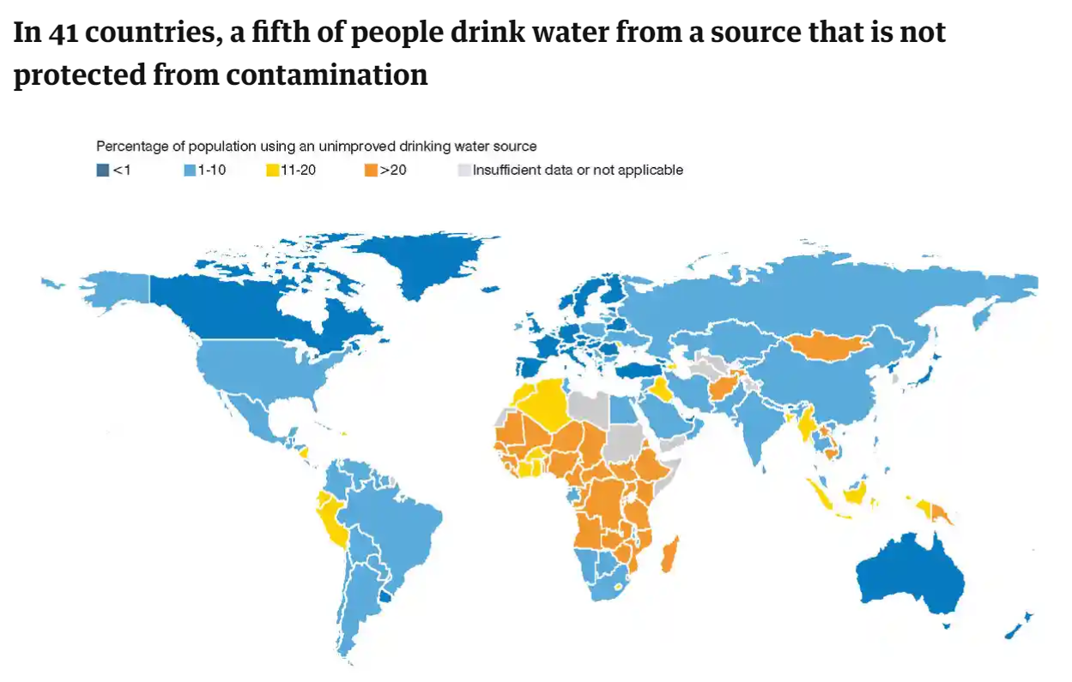
“Huge inequalities persist between and within countries; almost half of people drinking water from unprotected sources live in sub-Saharan Africa, eight in 10 live in rural areas, and there are large gaps between the richest and the poorest.”

Slide 73
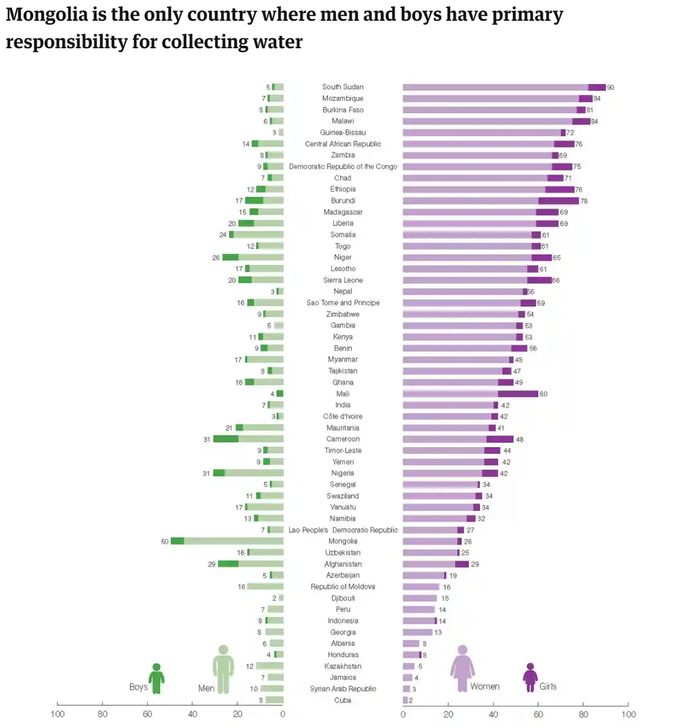
“In most countries, the majority of people spend less than 30 minutes collecting water, or have a piped supply within their home. But in some regions, especially sub-Saharan Africa, many people spend more than 30 minutes – and some more than an hour – on each trip to collect water. This burden still falls mainly on women and girls – they are responsible for this task in eight in 10 households that don’t have a piped supply.”

Slide 74
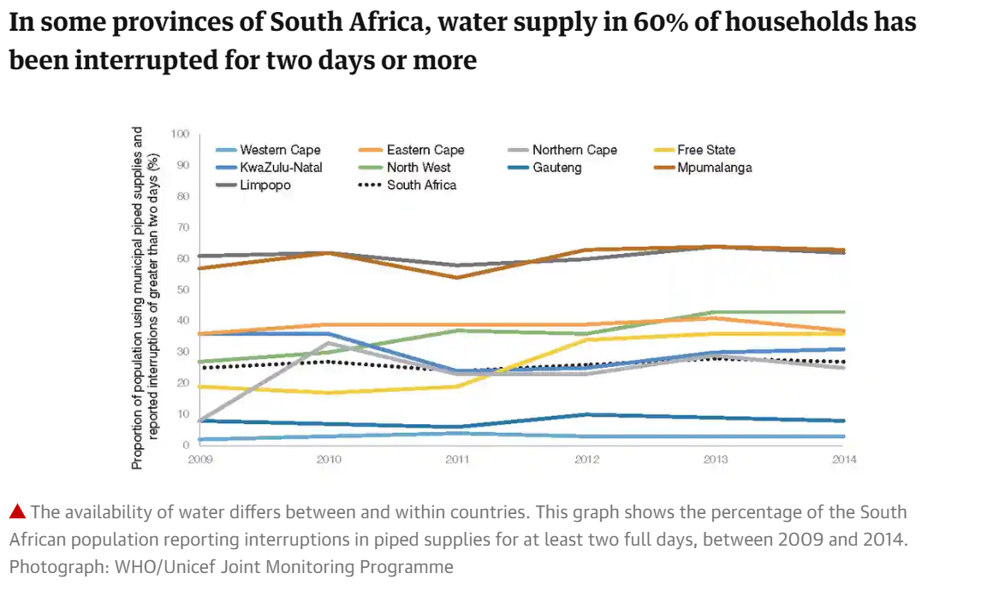
“In South Africa in 2014, a fifth of households with municipal piped water had interruptions that lasted for more than two days. This was three times higher in some regions of the country. Few countries have water available continuously, but in many parts of the world a less than 24-hour supply is still considered sufficient”

Slide 75
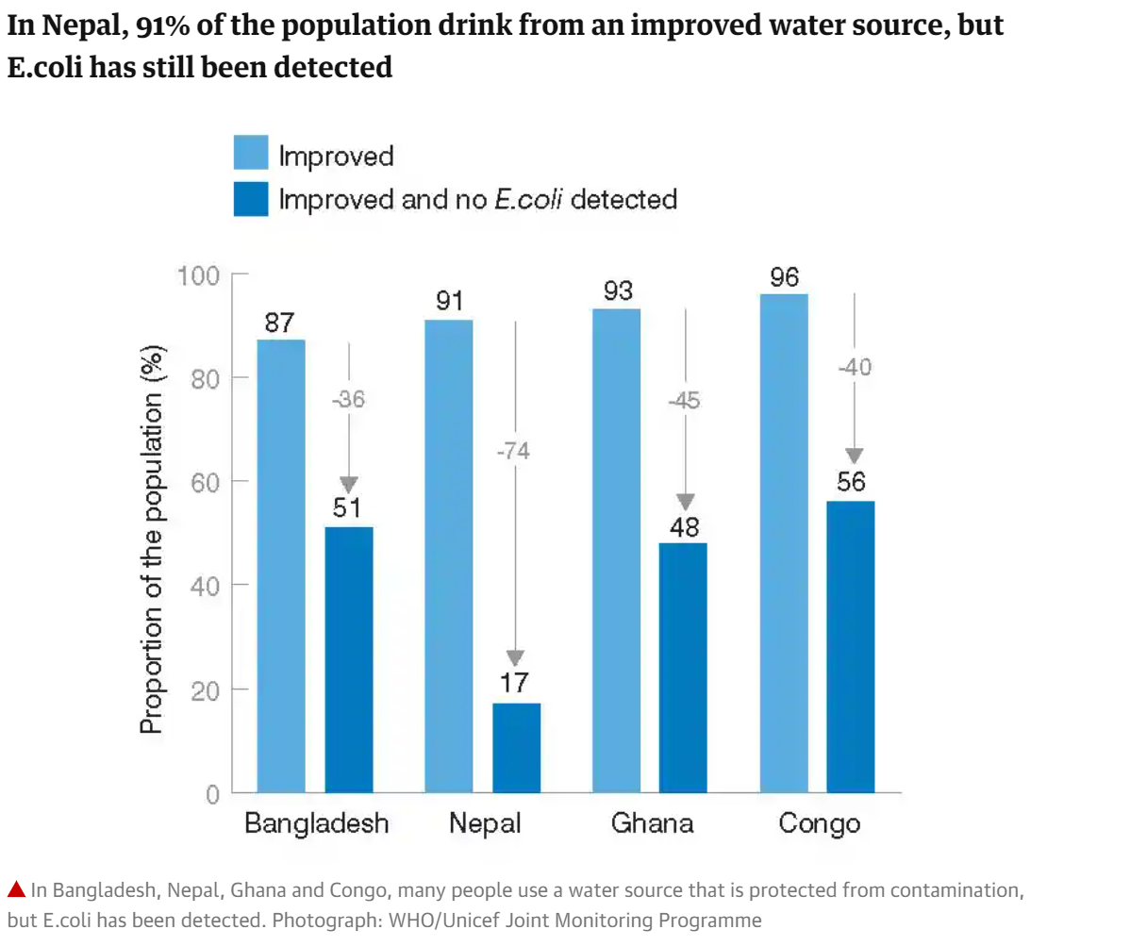
“To be considered “safe”, a source of drinking water must be free from pathogens and high levels of harmful substances. Globally, the main health concern is faecal contamination, which is identified by the presence of bacteria such as E.coli. In many places, a water point is designed to protect against contamination, but the water from it might still have traces of E.coli – the groundwater may be contaminated by faulty latrines, or the containers people use to carry and store water may contain traces of the bacteria.”

Slide 76
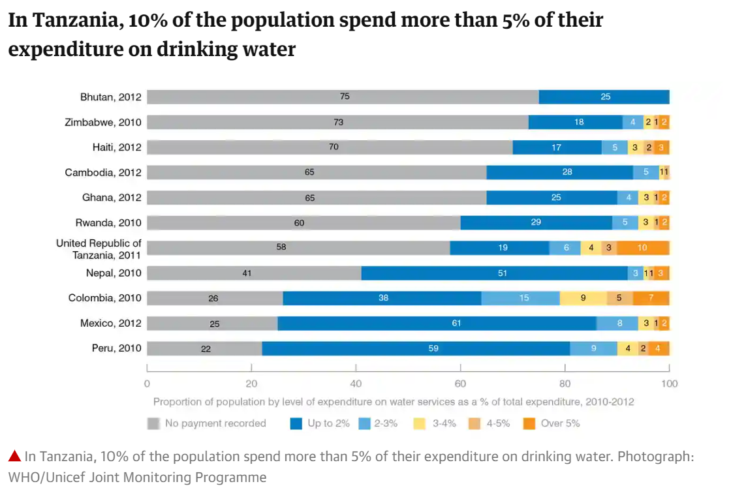
“Thanks to income and spending surveys, we know what people pay for water and sanitation varies from country to country. Data do not always capture the full costs of such services, such as the price to drill a borehole or get a household connection in the first place. We don’t know if paying for water and sanitation will prevent people from getting access to them in the first place, or whether people think the amount they pay already is affordable.”

Slide 77
Challenges to addressing this barrier:
“In 2013, the UN Deputy Secretary General issued a call to action on sanitation that included the elimination of open defecation by 2025. Achieving universal access to a basic drinking water source appears within reach, but universal access to basic sanitation will require additional efforts.
The situation of the urban poor poses a growing challenge as they live increasingly in mega cities where sewerage is precarious or non-existent and space for toilets and removal of waste is at a premium. Inequalities in access are compounded when sewage removed from wealthier households is discharged into storm drains, waterways or landfills, polluting poor residential areas.
Limited data available on this topic suggests that a large proportion of wastewater in developing countries is discharged partially treated or untreated directly into rivers, lakes or the ocean.
Wastewater is increasingly seen as a resource providing reliable water and nutrients for food production to feed growing urban populations. Yet this requires: management practices that ensure wastewater is sufficiently treated and safely reused; institutional oversight and regulation; and public education campaigns to inform people about wastewater use.”
WHO, 2019

Slide 78
How do these 5 barriers interrelate?
TASK: Create as many links between the 5 barriers as you can
Famine causes poverty and malnutrition
Drought leads to crop failure and ceased food production, which leads to famine.
Lack of clean water leads to disease outbreaks like Cholera, Tuberculosis and Diarrhoea.
Disease outbreaks can cause schools to shut down and contributes to the poverty cycle as individuals have a more limited education.
Poverty can cause malnutrition

Slide 79
How do these barriers make it hard to address the social determinants?
Stress-lack of food/inability to work creates stress.
Work-diseases spread through workplaces quickly.
Unemployment-individuals who are diseased are unable to work
Early Life-young children exposed to unclean water and famine suffer malnutrition and a range of developmental issues.
Food-droughts often lead to famine and malnutrition issues.
Transport-individuals in a state of poverty have limited means of transport.
Social gradient-famine, drought and poverty are often associated with individuals who are lower on the social gradient.
Social exclusion-individuals who suffer diseases are often outcast from society.

Slide 80
Sources:
https://www.theguardian.com/global-development-professionals-network/2017/mar/17/access-to-drinking-water-world-six-infographics
http://theconversation.com/recent-australian-droughts-may-be-the-worst-in-800-years-94292
http://www.who.int/en/news-room/detail/11-05-2017-who-calls-for-immediate-action-to-save-lives-in-somalia
http://www.who.int/news-room/headlines/15-09-2017-world-hunger-again-on-the-rise-driven-by-conflict-and-climate-change-new-un-report-says
http://www.who.int/csr/don/archive/year/2017/en/
Lockhart, E. (2015) Health Studies Year 12 ATAR.

Slide 81
United nations sustainable development goals
Term 3
Week 1

Slide 82
Syllabus content
Purpose of, and progress towards, the following five United Nations Sustainable Development Goals:
End hunger, achieve food security and improved nutrition and promote sustainable agriculture. (Goal 2)
Ensure healthy lives and promote well-being for all at all ages. (Goal 3)
Ensure inclusive and equitable quality education and promote lifelong learning opportunities for all. (Goal 4)
Achieve gender equality and empower all women and girls. (Goal 5)
Ensure availability and sustainable management of water and sanitation for all. (Goal 6)

Slide 83
What are the sustainable development goals? (SDG’s)
“On 1 January 2016, the 17 Sustainable Development Goals (SDGs) of the 2030 Agenda for Sustainable Development — adopted by world leaders in September 2015 at an historic UN Summit — officially came into force. Over the next fifteen years, with these new Goals that universally apply to all, countries will mobilize efforts to end all forms of poverty, fight inequalities and tackle climate change, while ensuring that no one is left behind.”
-UN website
** They build on pre-existing success of the “Millennium Development Goals”

Slide 84
What are the sdg’s? (ContiNUed)
Aim to go further to end all forms of poverty.
The Goals call for action by all countries, poor, rich and middle-income to promote prosperity while protecting the planet.
They recognize that ending poverty must go hand-in-hand with strategies that build economic growth and addresses a range of social needs including education, health, social protection, and job opportunities, while tackling climate change and environmental protection.
They are not legally binding but governments are expected to take ownership and establish national frameworks for the achievement of the 17 Goals.

Slide 85
Overarching PURPOSE of SDG’S:
End poverty
Protect the planet
Ensure prosperity for all.
“ P E E ”
For the goals to be reached, everyone needs to do their part: governments, the private sector, civil society and every individual.

Slide 86

12 Health studies: Our 5 focus goals
https://www.un.org/sustainabledevelopment/sustainable-development-goals/

Slide 87
What you need to know:
Step one: Know the shortened version of each goal.
Step two: Know the lengthened version of each goal.
Step three: Know some statistics that demonstrate the need for each goal (the issues).
Step four: Know some of the key targets the goal is aiming to achieve.
Step five: Know some strategies being used to achieve these goals.
Step six: Know the progress made towards each goal so far.
**I suggest knowing three goals VERY WELL, and all five relatively well.

Slide 88
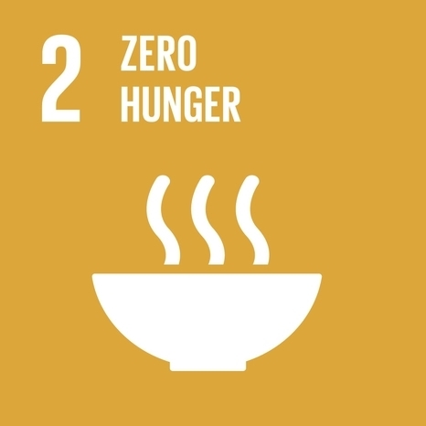
Goal 2: zero hunger
Goal 2: End hunger, achieve food security and improved nutrition and promote sustainable agriculture

Slide 89
The issues:
815 million people worldwide don’t have enough food to be healthy. (this statistic is predicted to rise by 2 billion by 2050)
The earths soils, freshwater, oceans and forest stores are being depleted.
Climate change is putting pressure on our precious resources
Many people who live in rural areas around the world are being forced into metropolitan areas in search of work due to the inconsistency of crop production.
World events such as war have a negative impact on the availability of food and destroys the environment which is critical for agriculture.

Slide 90
Targets for goal 2
By 2030, end hunger and ensure access by all people, in particular the poor and people in vulnerable situations, including infants, to safe, nutritious and sufficient food all year round.
By 2030, end all forms of malnutrition, including achieving the internationally agreed targets on stunting and wasting in children under 5 years of age, and address the nutritional needs of adolescent girls, pregnant and lactating women and older persons
By 2030, double the agricultural productivity and incomes of small-scale food producers, in particular women, indigenous peoples, family farmers, pastoralists and fishers

Slide 91
Strategies to achieve these targets?
Ensuring secure and equal access to land, financial services, farming knowledge, and markets.
Implementing resilient agricultural practices that increase productivity and production
Maintain genetic diversity of seeds and plants.
Increased investment in rural agriculture, agricultural research and technology development
Correct and prevent trade restrictions and distortions.

Slide 92
Progress made so far?
The proportion of undernourished people worldwide declined from 15 per cent in 2000-2002 to about 11 per cent in 2014-2016.
In 2016, an estimated 155 million children under age 5 were stunted (low height for their age) Globally, the stunting rate fell from 33 per cent in 2000 to 23 per cent in 2016.
NOTE: The number of overweight children increased from 30million in 2000 to 41million in 2016.
WHY does this trend exist?
At the current rate of progress, the world will not meet the zero hunger target by 2030, despite major advances since 2000.
Read the following article: World hunger is still not going down after three years and obesity is still growing – UN report
https://www.who.int/news-room/detail/15-07-2019-world-hunger-is-still-not-going-down-after-three-years-and-obesity-is-still-growing-un-report

Slide 93

Goal 3: good health & wellbeing
Goal 3: Ensure healthy lives and promote well-being for all at all ages.

Slide 94
The issues:
More than six million children still die before their fifth birthday each year
At the end of 2013, there were an estimated 35 million people living with HIV
Only half of women in developing regions receive the recommended amount of health care they need.
There is a large discrepancy in life expectancy across different countries.

Slide 95
Targets for goal 3
By 2030, reduce the global maternal mortality ratio to less than 70 per 100,000 live births
By 2030, end the epidemics of AIDS, tuberculosis, malaria and neglected tropical diseases and combat hepatitis, water-borne diseases and other communicable diseases
By 2020, halve the number of global deaths and injuries from road traffic accidents
By 2030, ensure universal access to sexual and reproductive health-care services, including for family planning, information and education, and the integration of reproductive health into national strategies and programmes
By 2030, substantially reduce the number of deaths and illnesses from hazardous chemicals and air, water and soil pollution and contamination

Slide 96
Strategies to achieve these targets
Individuals in wealthy countries can promote and protect their own health and the health of those around them by making well-informed decisions and participating in preventative initiatives like vaccinations and screening.
Raising awareness of health issues and advocate for funding to be redirected into prevention strategies.
Increasing education across the lifespan and ensuring that everyone has access to health care.
Ensuring universal access to safe, effective, quality, affordable medications.

Slide 97
Progress made so far?
Maternal mortality has fallen by almost 50 per cent since 1990
Measles vaccines have averted nearly 15.6 million deaths since 2000
13.6 million people had access to antiretroviral therapy by the end of 2014.
The period between 2000 and 2015 saw a 46 per cent reduction in HIV incidence; a 17 per cent decline in the incidence of tuberculosis; a 41 per cent decrease in the incidence of malaria
Still room to improve-traffic incidences increased and is not on track for 2030 goals.

Slide 98

Goal 4: quality education
Goal 4: Ensure inclusive and equitable quality education and promote lifelong learning opportunities for all.

Slide 99
The issues:
Enrolment in primary education in developing countries has reached 91 per cent but 57 million children remain out of school
More than half of children that have not enrolled in school live in sub-Saharan Africa
An estimated 50 per cent of out-of-school children of primary school age live in conflict-affected areas
103 million youth worldwide lack basic literacy skills, and more than 60 per cent of them are women
Lack of education keeps people in a cycle of poverty

Slide 100
The moment of Lift: M. Gates (Page 101)
“Why are there fewer girls than boys in secondary and postsecondary school? Economically, sending girls to school is a long term investment, and for families in extreme poverty, the focus is on survival. Families can’t spare the labor, or they can’t come up with the school fees.
Socially, women and girls don’t need an education to play the roles that traditional societies have prepared for them. In fact, women getting an education threatens traditional roles. Politically, it’s instructive to see that the most extremist forces in the world, like Boko Haram, which kidnapped 276 schoolgirls in northeast Nigeria in 2014, have been especially hostile to girl’s education. (Boko Haram’s name actually means “Western Education is forbidden”) The extremists are saying to women, “You don’t have to go to school to be who we want you to be.” So they burn down schools and kidnap girls, hoping that families will keep their girls home out of fear. Sending girls to school is a direct attack on their view that a woman’s duty is to serve a man.”

Slide 101
Targets for goal 4
By 2030, ensure that all girls and boys complete free, equitable and quality primary and secondary education
By 2030, ensure equal access for all women and men to affordable and quality technical, vocational and tertiary education, including university
Build and upgrade education facilities that are child, disability and gender sensitive and provide safe, nonviolent, inclusive and effective learning environments for all
By 2030, substantially increase the supply of qualified teachers, including through international cooperation for teacher training in developing countries, especially least developed countries and small island developing states

Slide 102
Strategies to achieve these targets
Ask our governments to place education as a priority in both policy and practice.
Lobby our governments to make firm commitments to provide free primary school education to all, including vulnerable or marginalized groups.
Encourage the private sector to invest resources in the development of educational tools and facilities
Urge NGOs to partner with youth and other groups to foster the importance of education within local communities
https://www.un.org/sustainabledevelopment/blog/2018/03/unicef-envoy-david-beckham-sets-sights-new-goal-ending-bullying-indonesias-schools/

Slide 103
Progress made so far?
Enrolment in primary education in developing countries has reached 91%.
Between 2000 and 2012, the percentage of out-of-school children among primary-school-age children has declined from 40% to 22% in sub-Saharan Africa and from 20% to 6% in South Asia.

Slide 104

Goal 5: gender equality
Goal 5: Achieve gender equality and empower all women and girls.

Slide 105
The issues:
Inequalities faced by girls can begin at birth and follow them all their lives. In some countries, girls are deprived of access to health care or proper nutrition, leading to a higher mortality rate.
As girls move into adolescence, gender disparities widen.
Child marriage affects girls far more than boys. Globally, nearly 15 million girls under age 18 are married every year—or 37,000 each day.
In sub-Saharan Africa, Oceania and Western Asia, girls still face barriers to entering both primary and secondary school.
Disadvantages in education translate into lack of access to skills and limited opportunities in the labour market.

Slide 106
Targets for goal 5
End all forms of discrimination against all women and girls everywhere
Eliminate all forms of violence against all women and girls in the public and private spheres, including trafficking and sexual abuse and other types of exploitation
Eliminate all harmful practices, such as child, early and forced marriage and female genital mutilation
Ensure universal access to sexual and reproductive health and reproductive rights

Slide 107




Strategies to achieve these targets
There are a range of campaigns that promote gender equality in a variety of fields. These include:
http://www.heforshe.org/en
http://www.unwomen.org/en
https://www.everywomaneverychild.org

Slide 108
Progress made so far?
As of 2014, 143 countries have guaranteed equality between men and women in their Constitutions but 52 have yet to take this step.
The harmful practice of female genital mutilation/cutting has declined by 24 per cent since around 2000.
Child marriage is declining, but not fast enough. Around 2000, nearly 1 in 3 women between 20 and 24 years of age reported that they were married before 18 years of age. Around 2015, the ratio was just over 1 in 4. The decline is driven by an even steeper reduction in the marriage rate among girls under 15 years of age during that period.

Slide 109

Goal 6: clean water & sanitation
Goal 6: Ensure availability and sustainable management of water and sanitation for all.

Slide 110
The issues:
Around 1.8 billion people globally use a source of drinking water that is fecally contaminated.
2.4 billion people lack access to basic sanitation services, such as toilets or latrines.
Water scarcity affects more than 40 per cent of the global population and is projected to rise.
More than 80 per cent of wastewater resulting from human activities is discharged into rivers or sea without any treatment, leading to pollution.
Water and sanitation-related diseases remain among the major causes of death in children under five; more than 800 children die every day from diarrhoeal diseases linked to poor hygiene.

Slide 111
Targets for goal 6
By 2030, achieve access to adequate and equitable sanitation and hygiene for all and end open defecation, paying special attention to the needs of women and girls and those in vulnerable situations
By 2020, protect and restore water-related ecosystems, including mountains, forests, wetlands, rivers, aquifers and lakes

Slide 112
Strategies to achieve these targets
Civil society organizations should work to keep governments accountable, invest in water research and development, and promote the inclusion of women, youth and indigenous communities in water resources governance.
Generating awareness of these roles and turning them into action will lead to win-win results and increased sustainability and integrity for both human and ecological systems.
Individuals can also get involved in the World Water Day and World Toilet Day campaigns that aim to provide information and inspiration to take action on hygiene issues.
http://www.worldtoiletday.info

Slide 113
Progress made so far?
In 2015, 6.6 billion people (over 90 per cent of the world’s population) used improved drinking water sources and 4.9 billion people (over two thirds of the world’s population) used improved sanitation facilities.

Slide 114
SDG Partnerships platform
Work in small groups to research one of the following campaigns/programs/initiatives that are working to achieve the sustainable development goals. Complete the mini-information posters and present your findings to the class ☺
Thank you water: https://thankyou.co/
He for She: https://www.heforshe.org/en
The Hunger Project: https://www.thp.org/rethink/campaign/
Unite for Quality Education: https://www.unite4education.org/
Polio Global Eradication Initiative: http://polioeradication.org/

Slide 115
Sources:
Picture retrieved from:
http://www.dtu.dk/english/news/2018/04/dtu-embraces-the-uns-17-sustainable-development-goals?id=564729c4-76e2-4b1c-92e9-5d0f5996af78
Lockhart, E. (2015) Health Studies Year 12 ATAR.

Slide 116
Health indicators between australia and developing countries
Term 3
Week 2

Slide 117
Syllabus content
Comparison of health indicators between Australia and developing countries
Life expectancy
Mortality
Morbidity

Slide 118
Definitions:
LIFE EXPECTANCY: Life expectancy is an indicator of how long a person is expected to live on average given the prevailing mortality rates.
MORTALITY: Mortality refers to death rate or the number of people dying in a population.
MORBIDITY: The number of people who are unhealthy, diseased or disabled.

Slide 119
Life expectancy
Commonly used to measure general population health status (key indicator)
High life expectancy rates tend to suggest high levels of healthcare, low infant mortality rates and an ageing population. What is AUSTRALIA’s life expectancy?
82.5 (2016, WHO) –difference between males and females?
https://www.youtube.com/watch?v=jbkSRLYSojo
Hans Rosling's 200 Countries, 200 Years, 4 Minutes - The Joy of Stats - BBC Four

Slide 120
Life expectancy
Using the following two websites, draw 3 separate conclusions regarding life expectancy throughout the world.
Gapminder
Index Mundi
(Data is similar, but not exactly the same-use both websites and draw general conclusions)
https://www.gapminder.org/tools/#$state$marker$axis_x$which=life_expectancy_years&spaceRef:null;;;&chart-type=barrank
https://www.indexmundi.com/g/r.aspx?v=30&t=0

Slide 121
What factors influence life expectancy?
Socioeconomic status, including employment, income, education and economic wellbeing
The quality of the health system and the ability of people to access it
Health behaviours such as tobacco and excessive alcohol consumption, poor nutrition and lack of exercise
Social factors
Genetic factors
Environmental factors including overcrowded housing, lack of clean drinking water and adequate sanitation.
Life expectancy is often shown in a population pyramid, as explained in the video below:
https://www.youtube.com/watch?v=RLmKfXwWQtE

Slide 122
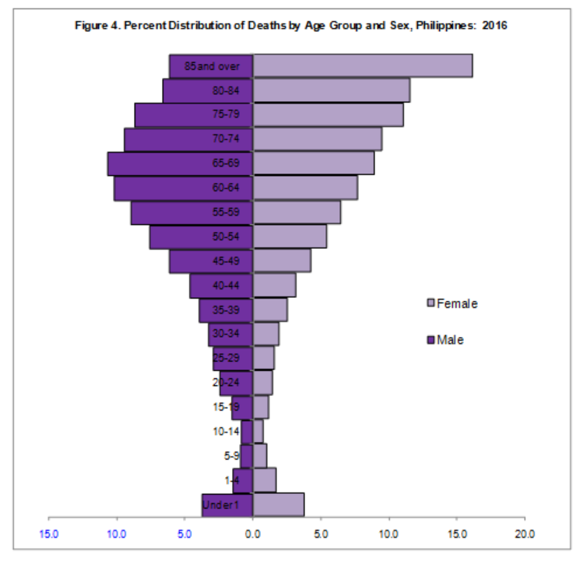
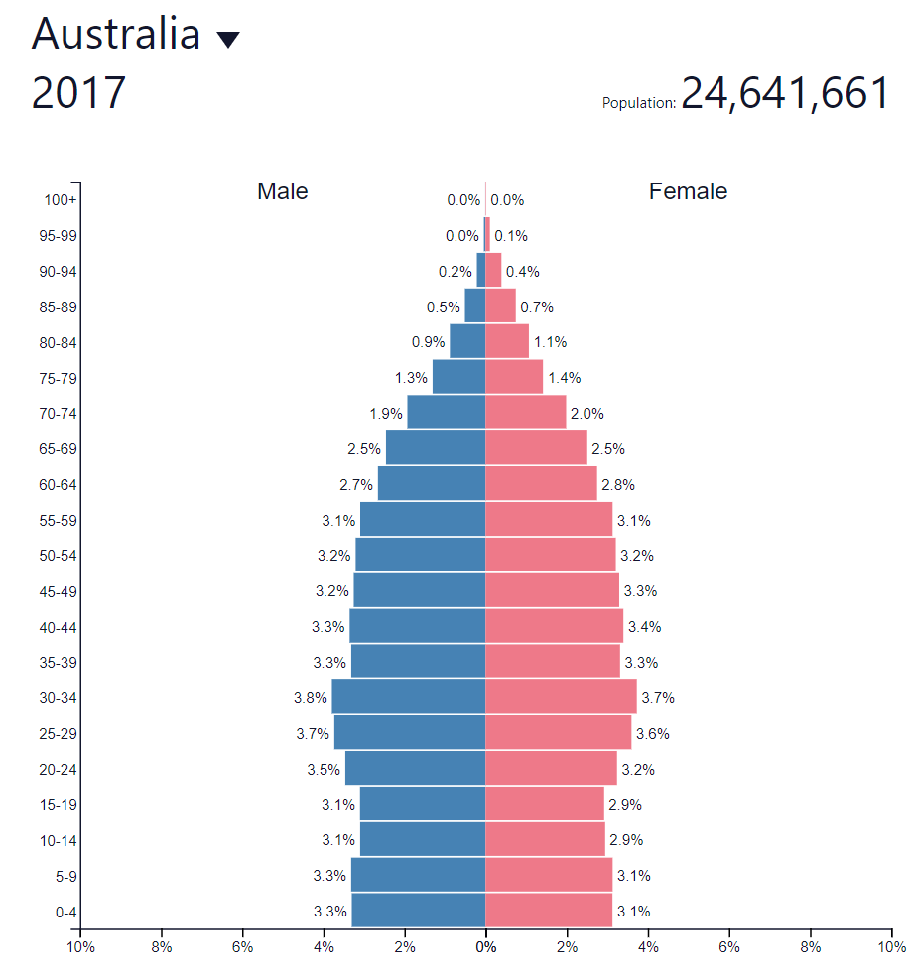
Draw conclusions from the graphs below:

Slide 123
mortality
Mortality can be measured in a range of ways and for different purposes.
Some of the most commonly used data comes in the following categories:
Infant mortality: infant mortality is the death of an infant before his or her first birthday
E.g. Globally, the infant mortality rate has decreased from an estimated rate of 65 deaths per 1000 live births in 1990 to 29 deaths per 1000 live births in 2017. Annual infant deaths have declined from 8.8 million in 1990 to 4.1 million in 2017.
Cause-specific mortality: the number of deaths from a specified cause
E.g. Malarial death rate of 280 per 100,000 population.
Maternal mortality rate: the death rate of women while pregnant or within 42 days of the end of pregnancy, regardless of the duration or outcome of the pregnancy.
E.g. In 2015, Nigeria’s maternal mortality rate was 814/100, 000. In Australia, 6/100,000.

Slide 124
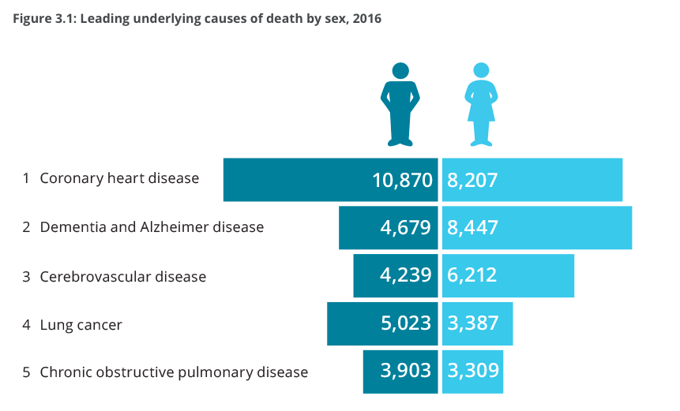
Leading causes of death in australia
Image retrieved from:
https://www.aihw.gov.au/reports/life-expectancy-death/deaths-in-australia/contents/leading-causes-of-death

Slide 125
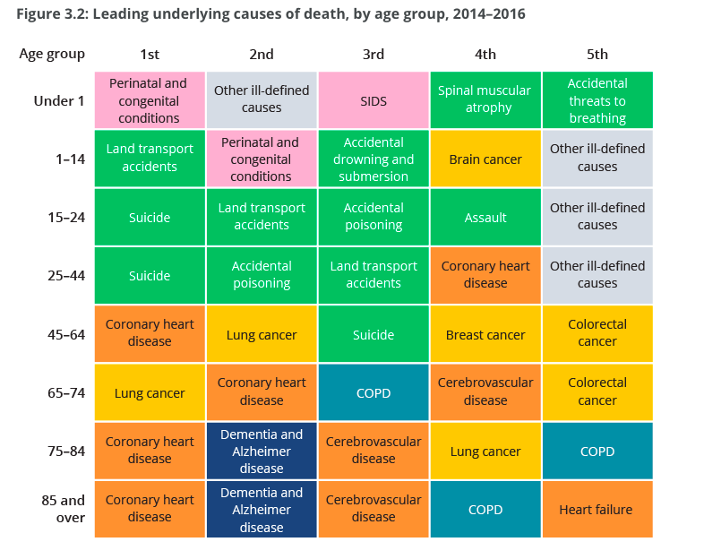
Leading causes of death in Australia
Image retrieved from
https://www.aihw.gov.au/reports/life-expectancy-death/deaths-in-australia/contents/leading-causes-of-death

Slide 126
Research using Healthdata.org
Neonatal disorders mean disturbance of normal state of body, organs and abnormal function of a newborn. Obstetricians play a major role to minimise the number of neonatal disorders. Prematurity, respiratory dysfunction, birth trauma, congenital malformations, neonatal infection and haemolytic disorders are the most common.
What are the 3 leading causes of death in the following developing countries?
UGANDA:
Neonatal disorders, HIV/AIDS, Malaria
VIETNAM:
Stroke, Ischemic heart disease, lung cancer.
SOMALIA:
lower respiratory infections, tuberculosis, neonatal disorders.
PHILIPPINES:
Ischemic heart disease, cancer, pneumonia
CHAD:
diarrheal diseases, lower respiratory infections, neonatal disorders

Slide 127
morbidity
The number of people who are unhealthy, diseased or disabled.
Usually a ratio/rate.
Common measures include incidence and prevalence of disease.
REMINDER: Incidence of Disease
Number of new cases of a disease in a population over a given period of time.
REMINDER: Prevalence of Disease
Number of overall cases of a disease in a population at a given point in time.
**these are better expressed as ratios with the TOTAL POPULATION number.

Slide 128
morbidity
This is an important measure as it can indicate the following:
The impact of disease for people who live in that population
The use and level of access of medical services
Use and availability of medication
Impact on families, workplaces and schools
Health or disease trends
The risk that individuals are at of contracting that disease.
It is hard to compare “healthiness” of countries using morbidity rates as they are usually measuring incidence and prevalence of different diseases and they cannot be directly compared.

Slide 129
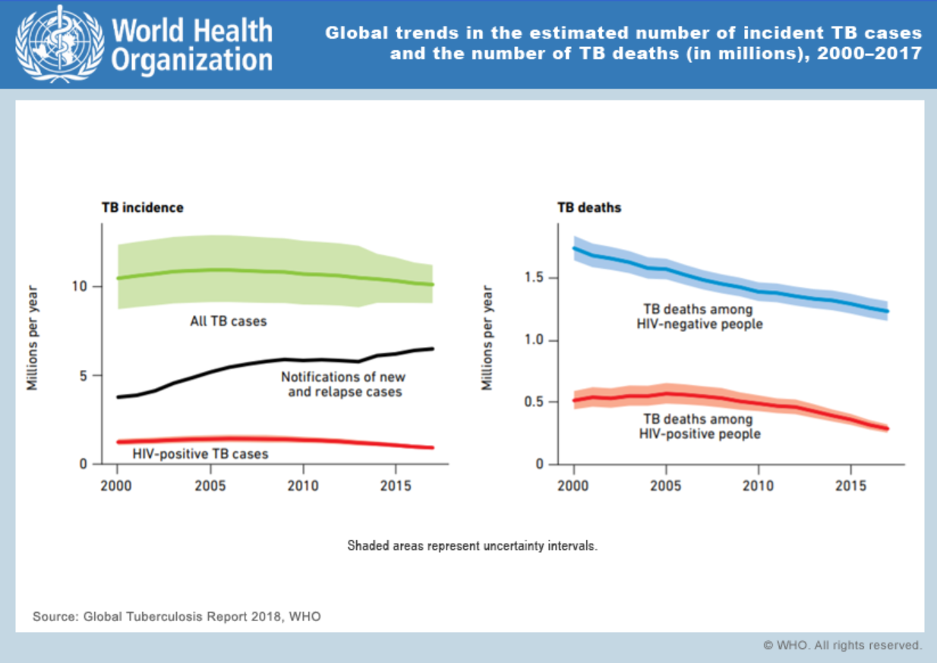

Slide 130
Application Task:
Using AIHW (or another credible source) find a graph that depicts one of the three health indicators we have discussed in Australia, and one that depicts the same health indicator in a developing country.
Write a short paragraph comparing and contrasting the two. Suggest reasons why they differ.

Slide 131
Application question: Life expectancy
The current life expectancy in Chad (Central Africa) is 54. In Australia, the current life expectancy is 83.5. Outline five reasons that could explain the difference in life expectancy between these two countries.
The public healthcare system in Australia is highly developed and ensures all Australians have access to quality healthcare despite their income and background.
The education levels in Australia are significantly higher than in Chad. This means Australian citizens have higher health literacy and a better understanding of how to look after their health.
There are very few communicable diseases that cause death in Australia. Vaccination rates are very high in comparison with Chad.
The infant mortality rate in Australia is one of the lowest in the world. This means very few babies don’t survive their first year of life. This increases the overall life expectancy.
A large proportion of the population of Chad live in poverty. (<$2 US/Day) This limits their opportunities to access healthcare, food, shelter and safety, which reduces life expectancy
Poor sanitation facilities in Chad compared with Australia. Poor sanitation fuels the spread of disease and increases morbidity rates.

Slide 132
Sources:
Lockhart, E. (2015) Health Studies Year 12 ATAR.
https://www.gapminder.org/tools/#$state$marker$axis_x$which=life_expectancy_years&spaceRef:null;;;&chart-type=barrank
https://www.ncbi.nlm.nih.gov/pubmed/11676112

Slide 133
Impact of world events
Term 3
Week 3

Slide 134
Syllabus content
Impact of world events on personal, social and cultural identity of population groups
Displacement from traditional homelands
War
Violence
Conflict
Natural disasters

Slide 135
We are more aware than ever of current events and happenings around the globe.
A lot of Australians have developed mechanisms to block out the emotional aspects to these events and they are seen as “terrible, but not my problem because they don’t affect me”
We are going to explore how these 5 types of world events influence the “personal, social and cultural identity of populations groups”

Slide 136
Identities…
Cultural identity: a sense of belonging to a particular ethnic or cultural group. Aspects of the individual are held due to the culture.
Social Identity: the identification of individuals as members of a group. They exhibit certain characteristics because they belong to that group.
Personal Identity: The characteristics of an individual that sets them apart from others. Ie. The things that make the individual who they are.

Slide 137
Displacement from traditional homelands
The temporary (or permanent) remove from original place of residence-includes house, region, land or country.
Internally displaced people are forced to leave their land within their country.
There were 31.1 million new internal displacements by conflict, violence and disasters in 2016.
Significant levels of displacement continued in the Middle East, with Syria, Iraq and Yemen experiencing close to two million new displacements in total during 2016.
Internally displaced vs stateless vs refugee…what’s the difference?

Slide 138
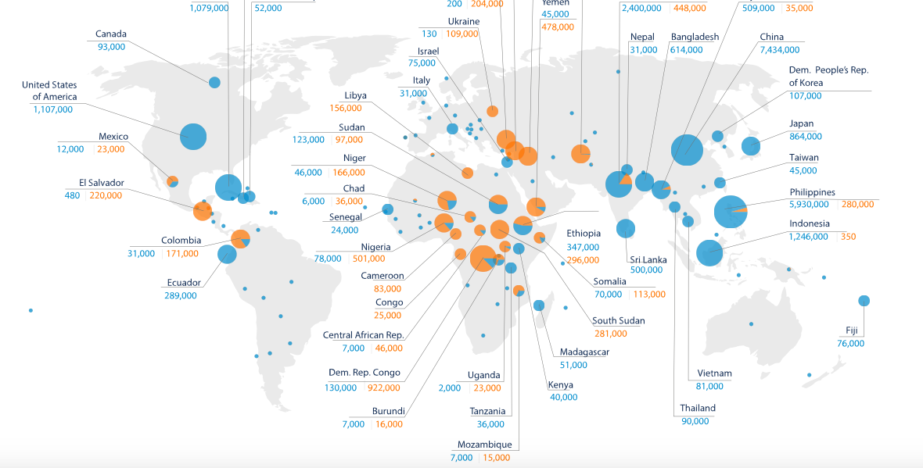

http://www.internal-displacement.org/global-report/grid2017/

Slide 139
INFLUENCE OF DISPLACEMENT ON IDENTITIES:
Individuals who are forced to flee their home often feel disconnected to their old self, their traditions, and their culture. (loss of cultural identity)
Individuals who are forced to leave their families and friends often experience social isolation and lose their sense of social identity (who they are with their friends/family)
Individuals who are forced to create a new life in another country often experience racism and/or discrimination and therefore feel pressure to conform to the culture of their new surroundings.
These individuals often feel excluded and misunderstood by their new surroundings and feel unlike their true self (loss of personal identity)
Refugees often feel that they lose their culture of language and social norms in the transition into their new life in a new culture.

Slide 140
war
“State of armed conflict between different nations or different groups within a nation”
WELL KNOWN WARS IN HISTORY: WW1, WW2, Vietnam War, Russian Civil War, Spanish Civil War, Iraq War, War in Somalia, Gaza War, War in Sudan.
Read Textbook page 144 (and your memory from the film “God Grew Tired of Us” for a more in-depth look into the War in Sudan.

Slide 141
INLFUENCE OF WAR ON IDENTITIES:
Personal identities are often defined by events such as war, violence and conflict. Young children who grow up surrounded by these world events see these behaviours as “normal” and it becomes a part of their behaviour and ultimately, their personal identity.
Many countries exhibit social cohesion when remembering “fighting for their country” and this creates a strengthened, unified cultural identity . Ie. ANZACS form a part of the Australian Identity.
The destruction of culturally significant artifacts and buildings has often been used during war in an effort to destroy cultural identities.

Slide 142
violence
“Violence is a behaviour that includes physical force, intent to injure/hurt/damage/kill”
Violence is closely linked with conflict and war.
What kind of impact does exposure to violence have on an individual?
increased anxiety and stress
decreased hope, trust and desensitivity to violent behaviour
What else?

Slide 143
INFLUENCE OF VIOLENCE ON IDENTITIES:
Personal identities are often defined by events such as war, violence and conflict. Young children who grow up surrounded by these world events see these behaviours as “normal” and it becomes a part of their behaviour and ultimately, their personal identity.
Individuals who are exposed to high levels of violence (in a range of forms) often struggle to develop healthy conflict management skills. This can create a personal identity grounded in anger and violence.

Slide 144
conflict
“Conflict is serious disagreement or argument”
Conflict is often the beginning of war.
Conflict is often expressed by violence.

Slide 145
Influence of conflict on identities:
Personal identities are often defined by events such as war, violence and conflict. Young children who grow up surrounded by these world events see these behaviours as “normal” and it becomes a part of their behaviour and ultimately, their personal identity.
Conflict can be based on cultural differences. When conflict results in war and violence, identities can be either strengthened (when fighting for your beliefs and culture) or it can be weakened (if war destroys the people group and its environment)

Slide 146
Natural disasters
The effect of a natural hazard on the environment which results in financial, environmental and/or human loss
Examples? Tsunami, hurricane, tornado, volcanic eruption, bushfires, flood, earthquake, landslide, tornado.
Natural disasters can have a devastating impact on the environment and the people who live in that environment.
These events can be traumatic and can define an individual/communities life.

Slide 147
Influence of natural disasters on identities
Cultural identities are often lost with the destruction of traditions and sacred buildings such as temples or statues. (places of worship or cultural significance)
Loss of family and friends can influence social identities.
Natural Disasters often shape how an individual sees the world and influences their own personal identity

Slide 148
Sources:
http://www.internal-displacement.org/global-report/grid2017/
Lockhart, E. (2015) Health Studies Year 12 ATAR.
Gareth Evans, The University of Melbourne
http://www.gevans.org/speeches/speech440.html

Slide 149
Government policies and regulations
Term 3
Week 4

Slide 150
Syllabus content
Influence of government policies and regulations on beliefs, attitudes and values
Government policies and regulations that restrict or promote healthy behaviour
Relationship between health behaviours and proscriptive, prescriptive and popular norms

Slide 151
Attitudes, beliefs and values.
Government policies and regulations have an impact on our values, attitudes and beliefs.
Our beliefs and attitudes change often. (as new evidence proves our previously held belief to be wrong)
Our core values are unlikely to change. (these develop when we are young and only significant, traumatic, emotional events are likely to change them)
When new policies or regulations are made, we (the public) usually see and understand that the government is trying to keep us safe and healthy. Our attitude towards these behaviours is positive if we understand the purpose, and negative if we do not understand or value the purpose.

Slide 152
Structural interventions:
These interventions attempt to change behaviours by altering the environment where people live, work and play.
These interventions aim to modify the things that are beyond the control of the individuals.
They tackle the social and physical environment.
This approach is used when there is a large population group that requires the intervention (they are at-risk or experience a high prevalence of the issue)
They don’t aim to change attitudes directly, but often indirectly have an affect on attitudes.
See next slide for an example

Slide 153
Structural interventions: EXAMPLE
The National Injury Prevention Strategy 2020–2030.
The strategy will include a set of joint actions for governments, industry and the community. It will guide us on how to work together to increase safety.
It will include priority actions for:
injuries that are a high burden on the community
groups at high risk of injury
injuries with high success rates from prevention measures
What kinds of actions/policies do you think will play a role in this strategy?

Slide 154
Regulations
Healthy Public Policy can be implemented in a variety of ways; one of which is creating or modifying regulations to govern behaviours.
Australians are affected by regulations both directly and indirectly.
The availability, cost and safety standards of many goods and services are maintained by regulations.
Can you think of any examples?
Certification or registration regulations
Licensing of products and services
Industry standards
Fees/taxes

Slide 155
Government policies/regulations that promote or restrict behaviours
Some policies ENABLE and HELP us to make healthy choices and others RESTRICT our level of freedom and choice.
Cyclists required by law to wear helmets
RSA qualification required to serve alcohol
Plain packaging on cigarettes so the government controls what is on the packet
Immunisations before welfare payments
Laws that restrict where people can drink alcohol or smoke tobacco
Restriction of the sale or cigarettes and alcohol to underage
Let’s list some more!!

Slide 156
Sources:
Lockhart, E. (2015) Health Studies Year 12 ATAR.
https://web.archive.org.au/awa/20091015041459mp_/http://www.nphp.gov.au/publications/sipp/nipspp.pdf
https://www.health.gov.au/initiatives-and-programs/national-injury-prevention-strategy-2020-2030-0

Slide 157
DEFINITIONS:
Proscriptive norms? Norms that ‘prohibit’ you from doing something. A behavior you should not do.
Prescriptive norms? Norms that ‘prescribe’ behavior, so they make you do something. A behavior you should do.
Popular norms? Norms made by people who are considered popular or who hold power. Fashionable norms or ‘trends of the day’. Popular norms are followed by people who are or want to be perceived as trendy or “in”.

Slide 158
How do these norms influence behaviour?
Proscriptive norms discourage us from behaving in a certain way. They make it more difficult for us to engage in the behaviour because it is socially unacceptable and we fear rejection or social isolation by those around us.
Prescriptive norms encourage us to engage in a particular behaviour. These behaviours are considered healthy and contribute to better health outcomes. We participate in prescriptive norms because we fear social isolation or rejection if we don’t follow the norm in this activity.
Popular Norms promote certain behaviours because of the way they endorse behaviours that are “trendy”. People who engage in these behaviours choose to do so as they place an importance on being popular and accepted by members of society who hold a higher social status.

Slide 159
Class activity
Choose a negative behavior that is prevalent in our society. Identify one proscriptive, one prescriptive norm and one popular norm for that behavior.
Behaviours could include (but are not limited to!) smoking tobacco, taking illicit drugs, drinking alcohol, sexting or eating junk food.

Slide 160
Sources:
Lockhart, E. (2015) Health Studies Year 12 ATAR.

Slide 161
Roles of the world health organisation
Term 3
Week 5

Slide 162
Syllabus content
Roles of the World Health Organisation (WHO)
Provide leadership
Provide technical support
Monitor the health situation and assessing health trends
Articulate ethical and evidence-based policy options
Set norms and standards
Shape the research agenda

Slide 163
LET’S TAKE A LOOK AT how they describe their purpose…
https://www.instagram.com/tv/B_kRc0QDiXo/?igshid=euij7w3n1rpa
“We are the directing and coordinating authority on international health within the United Nations’ system.”
WHO works worldwide to promote health, keep the world safe, and serve the vulnerable.
Our goal is to ensure that a billion more people have universal health coverage, to protect a billion more people from health emergencies, and provide a further billion people with better health and well-being.
Source: https://www.who.int/about/what-we-do

Slide 164
For universal health coverage, we:
Focus on primary health care to improve access to quality essential services
Work towards sustainable financing and financial protection
Improve access to essential medicines and health products
Train the health workforce and advise on labour policies
Support people's participation in national health policies
Improve monitoring, data and information.
Source: https://www.who.int/about/what-we-do

Slide 165
For health emergencies, we:
Prepare for emergencies by identifying, mitigating and managing risks
Prevent emergencies and support development of tools necessary during outbreaks
Detect and respond to acute health emergencies
Support delivery of essential health services in fragile settings.
Source: https://www.who.int/about/what-we-do

Slide 166
For health and well-being we:
Address social determinants
Promote intersectoral approaches for health
Prioritize health in all policies and healthy settings.
Source: https://www.who.int/about/what-we-do

Slide 167
Through our work, we address:
Human capital is an intangible asset or quality not listed on a company's balance sheet. It can be classified as the economic value of a worker's experience and skills. This includes assets like education, training, intelligence, skills, health
Human capital across the life-course
Noncommunicable diseases prevention
Mental health promotion
Climate change in small island developing states
Antimicrobial resistance
Elimination and eradication of high-impact communicable diseases
Source: https://www.who.int/about/what-we-do

Slide 168
For each of the 6 roles outlined ahead:
Step one: know the acronym “SMAPPS”
Step two: know the basic, brief outline of all 6 roles
Step three: know the extended, accurate outline of all 6 roles
Step four: have some examples, and have an understanding of the types of action that fall under each role
We are going to look at the roles of WHO in relation to Covid19. We will apply this example as we go.

Slide 169
Role 1: ProviDe leadership
WHO provides leadership on matters critical to health and engaging in partnerships where joint action is needed.
What does this look like?
leading by example and set a direction for WHO’s work and purpose
Engaging in partnerships with countries, United Nations system, international organizations, civil society, foundations, academia and research institutions – to improve their health and support their development.
COVID 19
https://twitter.com/i/bookmarks

Slide 170
Role 2: provide technical support
Providing technical support, catalyzing change, and building sustainable institutional capacity
What does this look like?
Providing technical support in emergency crisis responses such as natural disasters.
Providing technical training for health professionals, educators and leaders to build the capacity for communities to function and develop and improve their health status.
COVID 19
https://www.who.int/emergencies/diseases/novel-coronavirus-2019/technical-guidance

Slide 171
Role 3: monitor the health situation
Monitor the health situation and assessing health trends
What does this look like?
Using epidemiological data and demographic trends to predict future trends
This occurs at a global, regional and country level.
Requires collecting/collating and analyzing data from a range of sources.
COVID 19
Tracking confirmed cases and deaths caused by corona virus across the globe.
Collating statistics to create risk assessments
https://www.who.int/emergencies/diseases/novel-coronavirus-2019/situation-reports

Slide 172
role 4: articulate ethical and evidence-Based policy options
Articulate? “to pronounce (something) clearly and distinctly.”
Articulating ethical and evidence-based policy options.
What does this look like?
Using science-based approaches to develop policies to protect humanity and improve health.
Disseminating successful methods and tools, experience and best practices among partners and other countries
Use Monitoring and evaluation processes that document the lessons learned from the use of an array of evidence-to-policy processes in different contexts
COVID 19
Utilising the research being done around the world to provide effective, evidence-based policies for countries to adopt to reduce the impact of Covic-19 in their own backyards.
https://www.who.int/alliance-hpsr/news/2020/bringing-evidence-together-for-covid-19/en/

Slide 173
role 4: articulate ethical and evidence-based policy options (continued)
Articulating ethical and evidence-based policy options.
“WHO is and will remain a science- and evidence-based Organization with a focus on public health. The environment in which WHO operates is becoming ever more complex and politicized; however, WHO’s legitimacy and technical authority lie in its rigorous adherence to the systematic use of evidence as the basis for all policies. This also underpins the Organization’s core function of monitoring health trends and determinants at global, regional and country level.”

Slide 174
Role 5: set norms and standards
Setting norms and standards and promoting and monitoring their implementation
What does this look like?
Developing and promoting international standards for biological and pharmaceutical products
Utilising a team of epidemiologists, statisticians, infectious disease modellers, clinical trialists and regulatory experts to create appropriate norms and standards regarding health markers.
COVID 19
Creates standards for action plans to be implemented by the health governments of all countries affected.
In January 2020, The initial recommendation to confirm clearance of the virus, and thus allow discharge from isolation, required a patient to be clinically recovered and to have two negative RT-PCR results on sequential samples taken at least 24 hours apart.
At the end of May 2020, it changed to: For symptomatic patients: 10 days after symptom onset, plus at least 3 additional days without symptoms (including without fever and without respiratory symptoms)
For asymptomatic cases: 10 days after positive test for SARS-CoV-2

Slide 175
Role 6: shape the research agenda
Dissemination definition: “the act of spreading something, especially information, widely; circulation.”
Shaping the research agenda and stimulating the generation,
translation and dissemination of valuable knowledge.
What does this look like?
When WHO uses research to learn valuable health information, they then make it available to leadership and health professionals around the world.
To avoid unnecessary duplication of effort and to make sure that all important questions are being studied, research coordination on a global level is important. To that end, the International EMF Project, in collaboration with major national and multinational research funding institutions, has been providing such an umbrella for worldwide coordination and exchange of information about planned and ongoing projects.
COVID 19
“WHO is bringing the world’s scientists and global health professionals together to accelerate the research and development process, and develop new norms and standards to contain the spread of the coronavirus pandemic and help care for those affected.”

Slide 176
More practical examples of the role of the world health organisation…
Increase access to safe, effective, quality medicines and diagnostics.
Prevent people from falling into poverty because they have to pay for healthcare themselves.
Develop strategies to address critical shortages of health workers (like providing training).
Improve the availability, quality and analysis of health information.
Working with partners to ensure children receive healthcare.
Continue to provide immunisations against preventable diseases.
Assess children's growth according to a global standard to identify malnutrition and intervene appropriately.
Improve antenatal and postnatal care for all mothers and babies.
Increase access to sexual reproductive health services.

Slide 177
Who does the world health organization work with? (partnerships)
Organisations such as:
United Nations Children Fund (UNICEF)
Global Fund for AIDS
Oxfam
Medecins Sans Frontieres (Doctors without Borders)

Slide 178
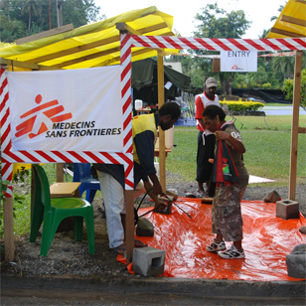
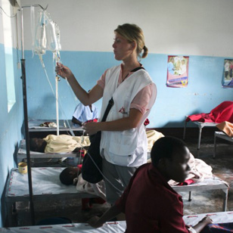
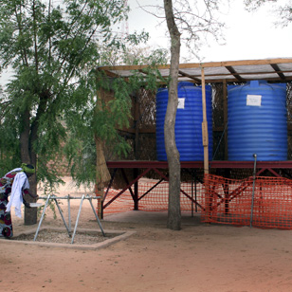
Example: Medecins Sans Frontieres
Cholera Outbreak Treatment Centre
http://ctc.msf.org/layout/en

Slide 179
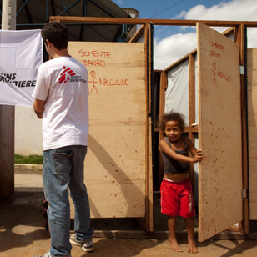
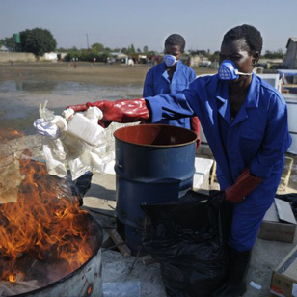

Slide 180
Sources:
Lockhart, E. (2015) Health Studies Year 12 ATAR.
World Health Organisation:
http://www.who.int
Medecins Sans Frontieres:
http://ctc.msf.org/layout/en
The Twelfth General Programme of Work, WHO
https://apps.who.int/iris/bitstream/handle/10665/112792/GPW_2014-2019_eng.pdf;jsessionid=4C54C37142281DDAE46BD227CCC8E074?sequence=1

Slide 181
Australia’s Aid Program
Term 3
Week 6

Slide 182
Syllabus content
Investment Priorities of Australia’s Aid program, how and why Australia provides aid in the following:
Humanitarian policy and partnerships
Education and Health
Gender Equality and empowering women and girls

Slide 183
Purpose of Australia’s aid program:
“The purpose of the aid program is to promote Australia’s national interests by contributing to sustainable economic growth and poverty reduction.”
-Australian Government (Department of Foreign Affairs and Trade) 2018
There is a focus on two development outcomes: supporting private sector development and strengthening human development.
PLEASE NOTE: it is sometimes referred to as the AUSaid program. (In older documents)
Let’s take a look at the Strategic Framework:
YOU MUST KNOW THIS WORD-FOR- WORD

Slide 184
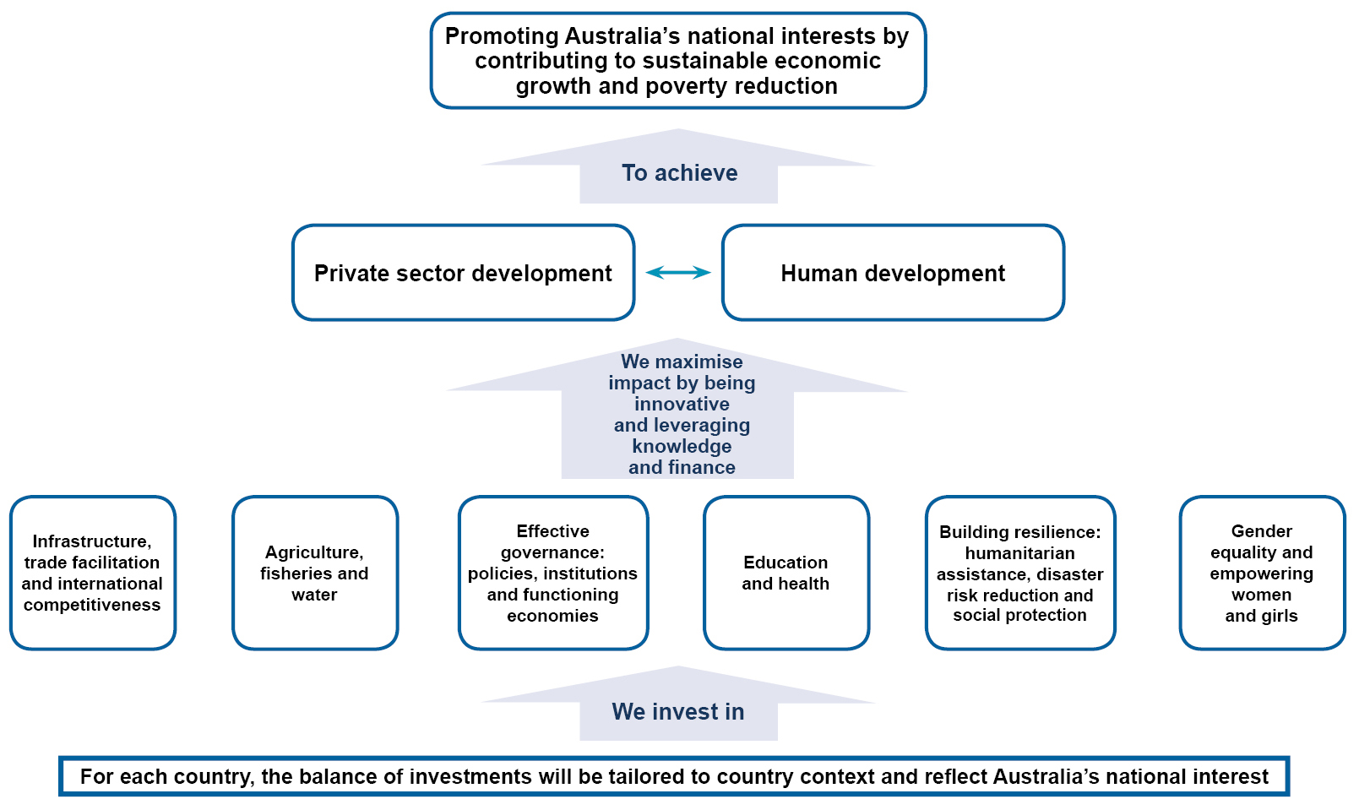
Figure 1: The strategic framework for the aid program: promoting prosperity, reducing poverty and enhancing stability

Slide 185
“Private sector Development”
“Australia's aid policy framework reflects an increasing focus on the private sector: as the source of economic growth, incomes and jobs; and as a partner with whom we can work to achieve faster and more sustainable development outcomes. Private sector development refers to DFAT’s work to support the growth of the private sector in developing countries.”
Building better business and investment environments: For example, reform of business registration processes, contracting laws, customs and trade regulation, enabling access to finance, and supporting the provision of essential hard and soft infrastructure.
Supporting growth in specific markets: For example, facilitating new business opportunities and removing barriers to efficient market operation, creating market incentives, improving the functioning of value and supply chains, supporting provision of key economic infrastructure through technical expertise and risk management, and providing anchor funding for market builders.
Maximising the development impact of businesses: For example, partnering with businesses to implement business models that serve the poor as consumers, producers or employees. (DFAT)

Slide 186
“human development”
Human development is about expanding the richness of human life, rather than simply the richness of the economy in which human beings live. It is an approach that is focused on people and their opportunities and choices.
People: human development focuses on improving the lives people lead rather than assuming that economic growth will lead to greater wellbeing for all. Income growth is seen as a means to development.
Opportunities: human development is about giving people more freedom to live lives they value. In effect this means developing people’s abilities and giving them a chance to use them. For example, educating a girl would build her skills, but it is of little use if she is denied access to jobs, or does not have the right skills for the local labour market. Three foundations for human development are to live a long, healthy and creative life, to be knowledgeable, and to have access to resources needed for a decent standard of living. Many other things are important too, especially in helping to create the right conditions for human development. Once the basics of human development are achieved, they open up opportunities for progress in other aspects of life.
Choice: human development is, fundamentally, about more choice. It is about providing people with opportunities, not insisting that they make use of them. No one can guarantee human happiness, and the choices people make are their own concern. The process of development – human development - should at least create an environment for people, individually and collectively, to develop to their full potential and to have a reasonable chance of leading productive and creative lives that they value.

Slide 187
Who does Australia’s aid program focus on?
Countries in the Indo-pacific region.
Examples:
In the PACIFIC REGION: Fiji, Samoa, Cook Islands, Tonga, Vanuatu
In the SOUTH EAST & EAST ASIA: Cambodia, Vietnam, Myanmar, Philippines
In the SOUTH & WEST ASIA: Afghanistan, Nepal, Pakistan, Sri Lanka
In the MIDDLE EAST & NORTH AFRICA: Iraq Humanitarian Response
There are also some alternate works going on in LATIN AMERICA & THE CARIBBEAN and SUB-SAHARAN AFRICA.

Slide 188
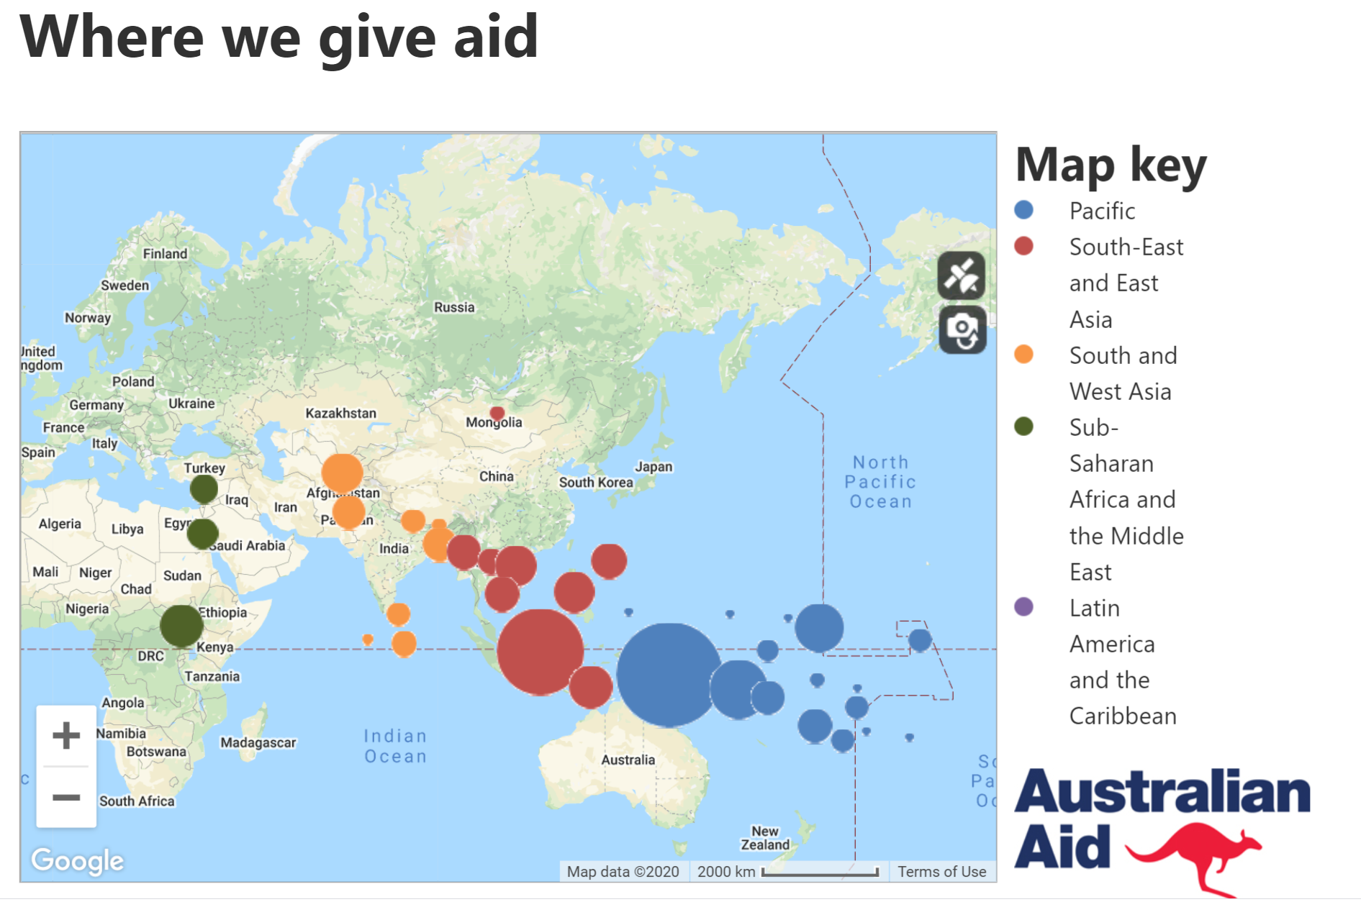
CLASS ACTIVITY:
Jump onto the website for Australia’s Aid program.
Find the countries/region that we give the MOST financial aid to, and who we give the LEAST financial aid to.
MOST: PNG ($546.3 Million)
LEAST: Tokelau/ Niue ($2.9 million)

Slide 189
Functions of australia’s aid program
We understand the purpose, and the functions are how that purpose is achieved.
Investments in the following areas:
Infrastructure, trade facilitation and international competitiveness
Agriculture, fisheries and water
Effective governance: policies, institutions and functioning economies
Education and health
Building resilience: humanitarian assistance, disaster risk reduction and social protection
Gender equality and empowering women and girls

Slide 190
Infrastructure, trade facilitation and international competitiveness
INFRASTRUCTURE: Improved ICT, transport, water and sanitation, reliable and affordable energy supply.
TRADE FACILITATION: changing regulations, increasing skilled workforce (ie training those who work at borders/customs) connecting farmers to international buyers.

Slide 191
Agriculture, fisheries and water
AGRICULTURE: ensuring farming practices are sustainable and highly productive-innovation in farming practises to increase production and improve food security.
FISHERIES: ensuring fishing practices are sustainable and have access to market systems.
WATER: increasing access to fresh, safe water for individuals who live in these countries.

Slide 192
Effective governance: policies, institutions and functioning economies
Australia assists in ensuring the governments are transparent and effective, as strong governance is key to improving health outcomes and ensuring countries are functioning effectively.
Ensuring that justice systems are fair and accountable
Ensuring that tax systems are fair and accountable
Build peace-keeping initatives

Slide 193
Education and health
EDUCATION: Australia is supporting changes to education systems/policies to deliver better education services in our region.
Particularly focusing on women and girls
Supporting teacher training
including children living with disability in education
improving education infrastructure (ie building schools and safe access)
aligning education with labour market needs.
HEALTH: Australia is investing to help strengthen health systems and policies to improve health outcomes in our region. NATIONAL INTEREST?-Prevents infectious diseases coming into Australia?
Communicable and non-communicable diseases
Improving access to sanitation facilities and clean water

Slide 194
Building resilience: humanitarian assistance, disaster risk reduction and social protection
Climate related disasters are becoming more frequent and more severe.
Australia has committed to responding promptly and effectively to humanitarian disasters (humanitarian: concerned with or seeking to promote human welfare)
Enhancing preparedness for disasters
Supporting investments in research of disaster risk
Strengthening disaster risk governance.

Slide 195
Gender equality and empowering women and girls
GENDER EQUALITY:
Enhancing womens voice in decision making and leadership
Ensuring equal access to education and pay in the job market
EMPOWERING WOMEN AND GIRLS:
Ending violence against women and girls
Enabling access for all women to reproductive health services

Slide 196
Practice Multiple Choice question
Australia’s overseas aid program provides investment for eligible countries to encourage governments to plan to fund their own economic growth and development. This is because
(a) Aid is the best means of kick-starting initiatives that promote economic growth.
(b) Australia has a responsibility to its neighbouring nations.
(c) Empowering women will only occur with the support of governments.
(d) Aid alone cannot solve the problems of poverty and poor economic growth.
ANSWER: D

Slide 197
Sources:
Lockhart, E. (2015) Health Studies Year 12 ATAR.
Department of Foreign Affairs and Trade
http://dfat.gov.au/aid/Pages/australias-aid-program.aspx

Slide 198
The national strategic framework for chronic conditions
Term 3
Week 7

Slide 199
Syllabus content
Objectives that support the vision of the National Strategic Framework for Chronic Conditions
Focus on prevention for a healthier Australia
Provide efficient, effective and appropriate care to support people with chronic conditions to optimise quality of life
Target priority populations.
Principles of the National Strategic Framework for Chronic Conditions:
Equity
Collaboration and partnerships
Access
Evidence-based
Person-centred approaches
Sustainability
Accountability and transparency
Shared responsibility

Slide 200
Let’s take it back a step…What is the NSFCC?
The Framework provides guidance for the development and implementation of policies, strategies, actions and services to reduce the impact of chronic conditions in Australia. It supersedes the National Chronic Disease Strategy 2005 and associated National Service Improvement Frameworks.
The Framework moves away from a disease-specific approach (NHPAs) and provides national direction applicable to a broad range of chronic conditions by recognising that there are often similar underlying principles for the prevention and management of many chronic conditions.
The Framework was endorsed by all Health Ministers, and publicly released in May 2017.
The timeframe for the framework is 8 years, with a review every 3 years

Slide 201
purpose of the nsfcc?
It is the overarching policy for the prevention and management of chronic conditions in Australia.
It provides guidance for the development and implementation of policies, strategies, actions and services to address chronic conditions and improve health outcomes

Slide 202
Who is it for?
The Framework is directed at decision and policy makers at national, state and local levels.
It is a useful resource for governments, the non-government sector, stakeholder organisations, local health service providers, private providers and industry members
Communities that advocate for, and provide care and education for, people with chronic conditions and their carers and families.

Slide 203
Who wrote it?
Australian Health Ministers’ Advisory Council, the Australian Government, in partnership with the states and territories.

Slide 204
Let’s define chronic conditions:
“In the Framework, the use of the term ‘chronic conditions’ encompasses a broad range of chronic and complex health conditions across the spectrum of illness, including mental illness, trauma, disability and genetic disorders”
Chronic conditions:
have complex and multiple causes;
usually have a gradual onset, although they can have sudden onset and acute stages;
can occur at any age, although they become more prevalent with older age;
can reduce quality of life and create limitations and disability;
are long-term and persistent
while not usually immediately life threatening, are the most common and leading cause of premature mortality.
EXAMPLES of chronic conditions?
PAIRS TASK: Create an inclusive definition for “Chronic Condition”

Slide 205
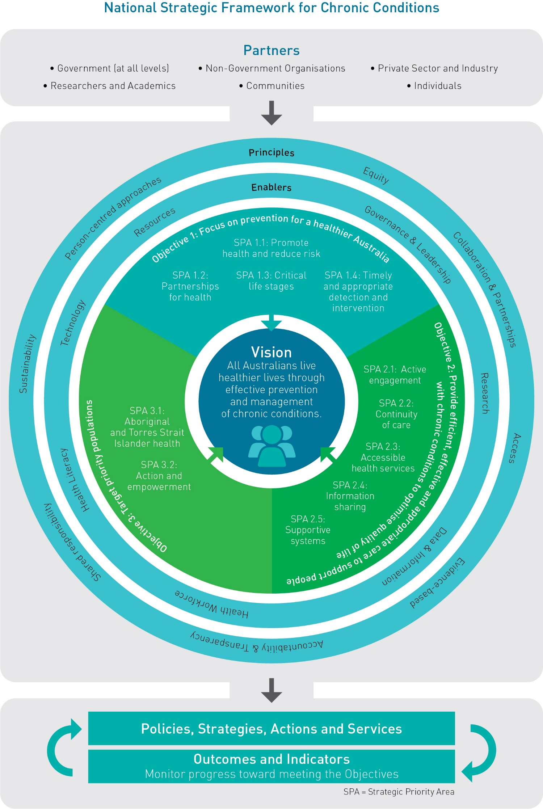

Slide 206
3 objectives of the nsfcc:
Focus on prevention for a healthier Australia
Provide efficient, effective and appropriate care to support people with chronic conditions to optimise quality of life
Target priority populations.

Slide 207
Objective #1
“Focus on prevention for a healthier Australia”
Prevention is better than cure!
If we can prevent rather than cure, this is better way to spend money and resources within the health system.
Prevention has economic benefits and delivers the greatest improvement in health outcomes for future Australian generations.
Many preventative strategies target behavioural risk factors.

Slide 208
Objective #1
What success will look like:
The proportion of Australians living with preventable chronic conditions or associated risk factors is reduced.
Australia meets the voluntary global targets outlined in the WHO Global Action Plan for the Prevention and Control of Non-communicable Diseases 2013–2020
Australians with chronic conditions, or associated risk factors, develop them later in life and receive timely interventions to achieve optimal health outcomes.

Slide 209
Objective #1
How will this be achieved?
HEALTH PROMOTION! Enabling, mediating and advocating!
Prevent or delay the onset of chronic conditions through modification of environmental, social and behavioural factors.
Minimize disease progression (from early symptoms onwards) and reduce the onset of other related chronic conditions
Creating partnerships for health
Timely and appropriate disease detection/intervention
Developing a life-course approach to prevention

Slide 210
Objective #2
“Provide efficient, effective and appropriate care to support people with chronic conditions to optimise quality of life”
All Australians are entitled to have access to effective healthcare
Chronic conditions are varied in their severity and functional impact, and therefore the support required is varied too.
The goal is to provide appropriate health care support for individuals with chronic conditions so they can experience improved quality of life.

Slide 211
Objective #2
What success will look like:
Australians with chronic conditions receive coordinated, person-centred and appropriate care.
Australians experience fewer complications, multi-morbidities or disabilities associated with chronic conditions.
Fewer Australians die prematurely due to specific chronic conditions.

Slide 212
Objective #2
How will this be achieved?
Active engagement of individuals with chronic conditions in the community
Continuity and coordination of care along the life course.
Consistent, available information and data on the latest technology and developments

Slide 213
Objective #3
“Target priority populations.”
Some population groups suffer from more chronic conditions than others.
WHY?
some populations are more exposed to more negative social, environmental, cultural and biomedical factors. These are beyond their control, and often AVOIDABLE.
these populations tend to experience poorer health, so health promotion needs to be focused on the elements that are causing these health inequities.

Slide 214
Objective #3
Target priority populations include but are not limited to:
Aboriginal and Torres Strait Islander people
People from culturally and linguistically diverse backgrounds
Older Australians
Carers of people with chronic conditions
People experiencing socio-economic disadvantage
People living in remote, or rural and regional locations
People with disability
People with mental illness
People who are, or have been, incarcerated.

Slide 215
Objective #3
What success will look like:
Priority populations have reduced risk of developing chronic conditions.
Priority populations experience fewer complications, multi-morbidities or disabilities associated with chronic conditions.
Aboriginal and Torres Strait Islander people have reduced risk of developing chronic conditions and those with chronic conditions have an improved life expectancy.

Slide 216
Objective #3
How will this be achieved?
Increased funding into prevention programs aimed at the priority populations (eg. Indigenous in Australia)
action and empowerment: community empowerment programs to improve the health condition of these priority populations.

Slide 217
Measuring success of 3 objectives?
How can we measure the effectiveness of these 3 objectives?
Decrease in hospitalisations and surgeries
Reduced incidence and prevalence of chronic conditions within the population
Decreased levels of obesity, smoking, unemployment etc. (risk behaviours and risk factors)

Slide 218
Class activity
You are to design an infographic style poster that informs its reader of the 3 main objectives of the National Strategic framework for Chronic Conditions.
You will use CANVA. (create and account if you don’t already have one)
It needs to be EYE-CATCHING and INFORMATIVE, including an outline of each objective, what success would look like and how success will be achieved.
You must write it in your own words.

Slide 219
Principles of nsfcc: Equity
Equity — all Australians receive safe, high-quality health care irrespective of background or personal circumstance.
Example of Equity?
Health care needs to be safe and available for all, and have an appropriate monitoring process.

Slide 220
Principles of nsfcc: Collaboration and Partnerships
Collaboration and partnerships — identify linkages and act upon opportunities to cooperate and partner responsibly to achieve greater impacts than those that can occur in isolation.
Who might be a part of these partnerships?
Government sector (eg. health department)
Small businesses in the health industry (eg. Allied Health services)
Health promotion programs (eg. Healthway)
Example of Collaboration and Partnerships?
Researchers work together to pool their resources to improve the outcome.

Slide 221
Principles of nsfcc: access
Access — high standard, appropriate support and services are available, accessible, equitable and affordable for all Australians.
(think about the 5A’s of access)
Example of Access?
Vaccinations need to be free (or government subsidised) so all individuals can get vaccinated regardless of where they live in the country.

Slide 222
Principles of nsfcc: evidence based
Evidence-based — rigorous, relevant and current evidence informs best practice and strengthens the knowledge base to effectively prevent and manage chronic conditions.
Example of Evidence Based?
All Health interventions are implemented after significant research and evidence suggests the best course of action for the given situation.

Slide 223
Principles of nsfcc: person centred approaches
Person-centred approaches — the health system is shaped to recognise and value the needs of individuals, their carers and their families, to provide holistic care and support.
Holistic: well rounded. Recognises that all parts are interconnected and influence each other.
Example of Person Centred Approaches?
People are treated as a “person” not a “number” within the health system. Their health is treated in its entirety.

Slide 224
Principles of nsfcc: sustainability
Sustainability — strategic planning and responsible management of resources delivers long-term improved health outcomes.
Example of Sustainability?
Looking for long term solutions/treatments to health problems.

Slide 225
Principles of nsfcc: accountability and transparency
Accountability and transparency — decisions and responsibilities are clear and accountable, and achieve best value with public resources.
Example of Accountability and Transparency?
Throughout the process of implementing a health intervention, the health professionals provide information on progress and reasoning behind decision making.

Slide 226
Principles of nsfcc: shared responsibility
Shared responsibility — all parties understand, accept and fulfil their roles and responsibilities to ensure enhanced health outcomes for all Australians.
Example of Shared Responsibility?
Groups involved should be aware of other stakeholders and share information and decision making to improve outcomes.

Slide 227
Acronym??
“PEACE-ASS”

Slide 228
Sources:
Lockhart, E. (2015) Health Studies Year 12 ATAR.
Australian Health Ministers’ Advisory Council, 2017, National Strategic Framework for Chronic Conditions. Australian Government. Canberra.

Slide 229
Communication skills in health settings
Term 3
Week 8

Slide 230
Syllabus content
Communication and collaboration skills in health settings
Mediation
Negotiation
Compromise
Managing conflict
Arbitration
Leadership
Facilitation

Slide 231
health settings
What are considered “Health Settings”?
-anywhere where health can be improved/advanced.
Class Activity:
Textbook page 100
Activity 6.2
Q.1-4

Slide 232
mediation
An impartial party/person that acts between disputing parties to resolve differences and bring about a settlement.
What might this look like in a health setting?
Mediation between disputing governing bodies, health professionals and patients.

Slide 233
negotiation
The process of achieving agreement through discussion, used to resolve disputes. Negotiators bargain for individual or collective advantage and usually through a “give and take” scenario.
What might this look like in a health setting?
Pricing of health products and services

Slide 234
compromise
A middle point between two extremes-finding agreement through communication and a mutual acceptance of terms.
What might this look like in a health setting?
Health professionals compromising?

Slide 235
Managing conflict
Conflict is natural and not always a bad thing. Each individual needs to respond to conflict with wisdom and understanding for it to result in growth and moving forward.
There are different types of conflict:
Intrapersonal: within the individual
Interpersonal: between two or more individuals
Intragroup: within the members of a group/team
Intergroup: between two or more groups/teams
Individuals require a set of effective communication and collaboration skills to move forward through conflict.

Slide 236
arbitration
The process through which two or more parties using a third party in order to resolve a dispute.
Unlike mediation, the third party actually MAKES the decision (the ruling is made separate to the two parties)

Slide 237
leadership
The process of of social influence in which one person can enlist the aid and support of others in the accomplishment of a common task.
What might this look like in a health setting?
Leading a health team to meet a common goal on a health project.

Slide 238
facilitation
The act of making something easier, assisting the progress or improvement of something.
What might this look like in a health setting?
Offering assistance for health professionals.

Slide 239
Sources:
Lockhart, E. (2015) Health Studies Year 12 ATAR.

Slide 240
Graphs and tables practice

Slide 241
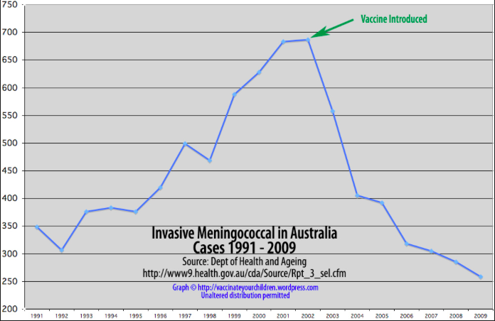
Draw conclusions from the following tables/graphs.
Graph retrieved from https://vaccinateyourchildren.wordpress.com/graphs-and-data/

Slide 242
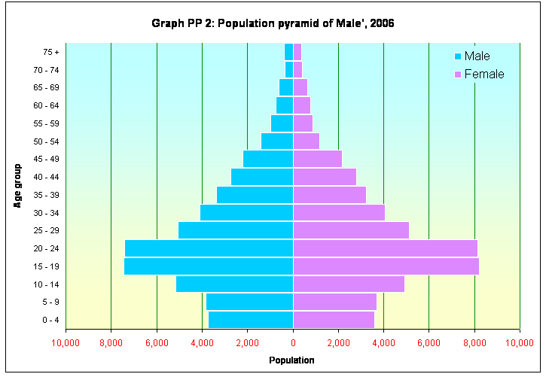
Graph retrieved from http://statisticsmaldives.gov.mv/nbs/wp-content/uploads/2006/12/Population&HousingCensus2006/graphs/PP2.htm

Slide 243
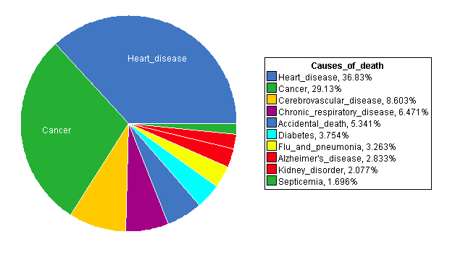
Graph retrieved from https://www.statcrunch.com/5.0/viewresult.php?resid=761973

Slide 244
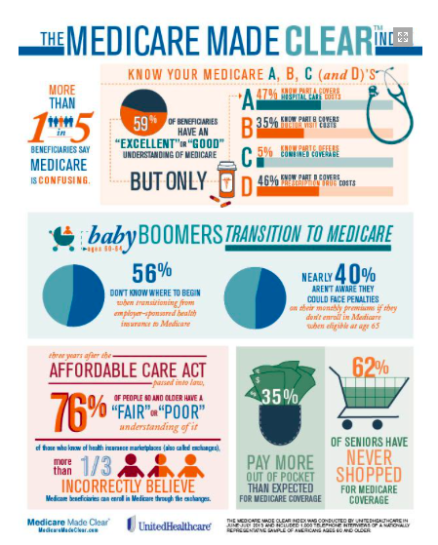
Infographic retrieved from http://www.croweandassociates.com/medicare-employer-information-form/

Slide 245
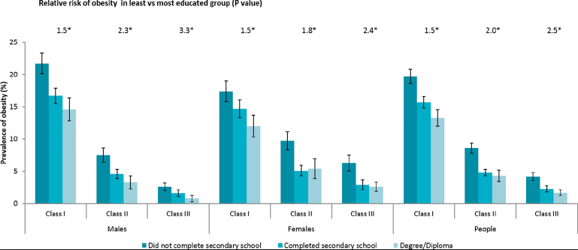
Table retrieved from https://www.researchgate.net/figure/Prevalence-of-class-I-II-and-III-obesity-by-education-level-in-Australia-2011-12-p_fig1_273326209

